Slide 1








STORYTELLING THROUGH DIGITAL PHOTOGRAPHY
WP3 Methodology
Foundations of Digital Storytelling
Funded by the European Union. Views and opinions expressed are however those of the author(s) only and do not necessarily reflect those of the European Union or the European Education and Culture Executive Agency (EACEA). Neither the European Union nor EACEA can be held responsible for them.

Slide 2
CONTENTS
Webinar 1: Foundations of Digital Storytelling
Why tell stories? What is digital storytelling
Story structure for visual narratives, part 1
Story structure for visual narratives, part 2
Emotional Resonance through images
Best Practices for Storytelling with Photography
Activity 1
Activity 2
Reflection and Q&A
References and bibliography
Notes:
Here's our roadmap. We'll move from theory to practice quickly, with two hands-on activities

Slide 3
THE SHOOT STORY-TELLING METHODOLOGY
This methodology introduces an innovative approach to teaching by integrating digital storytelling through photography.
Rooted in neuroscience, storytelling fosters emotional connections, making information more accessible and memorable.
It addresses challenges faced by unmotivated students and those with learning difficulties by leveraging contemporary technologies to create an engaging, inclusive learning environment.
Storytelling increases engagement, creativity, and comprehension across curricular subjects, while accommodating diverse learning needs, including students with learning difficulties.

Slide 4
THE SHOOT STORY-TELLING METHODOLOGY
THE COMPLETE FRAMEWORK
This methodology includes a series of 3 webinars and guidelines for trainers. It is meant to be used along with the collection of Best Practices on Digital Storytelling which are also part of WP3.
It builds on the knowledge acquired through the "Teaching through Digital Immersive Photography" Student and Teacher Handbooks developed in WP2.
The methodology webinars are part of a comprehensive educational ecosystem, where students actively create knoledge, deeply engaging with the different curricular topics, leading to WP4’s Student developped Immersive Lessons.

Slide 5



Webinar 1: Foundations of Digital Storytelling
Today we will explore:
- an introduction to digital storytelling,
- key elements in story structuring, - examples of telling stories using digital media and photography
Notes:
Let us dive into the exciting world of digital storytelling and explore together how photography can help us tell powerful stories.
Understand what digital storytelling is, its benefits, and its application in creating immersive lessons.
Why photographic narratives are strong, and how to create compelling narratives using digital images.

Slide 6

Why tell stories?
3 core reasons
1. Empowerment
Sharing voices and perspectives
Space for those who feel underrepresented when writing
Alternative to text-based communication
Approaching complex concepts differently
Notes:
Let's start with WHY. Throughout human history, stories have been our primary way of making sense of the world. Three reasons matter for education:
First, EMPOWERMENT. Stories can be democratic tools for change. When we tell stories, and even when we hear stories, we feel in control.
Not all students excel at writing essays. Photography gives them another language—one that can express complexity, emotion, and understanding without requiring perfect grammar. Students can create brilliant photo essays about concepts they couldn't write about.

Slide 7

Why tell stories? (cont.)
2. Reflection
Understanding ourselves and others
Exploring our thinking, identities, and ideas
3. Deep Learning
Moving beyond memorization
Achieving substantial understanding
Notes:
Second, REFLECTION. When we create stories we’re not just repeating facts. By making a story we are interpreting, connecting to our own lives, reflect on who we are and how we relate to others, to the world around and the complex events that happen daily.
Third, DEEP LEARNING. hat information delivered as stories is significantly more memorable than facts presented in isolation. Stories create context, emotion, and meaning—the three ingredients for lasting understanding. Think about it: you probably remember stories from childhood books, but struggle to recall lists you memorized for tests.

Slide 8

Why tell stories?
Can you find other reasons?
Why tell stories?
Why tell stories now?
Why people told stories in the past?
Personal memory: what's a story that changed how you see something?
Notes:
Students are free to talk but shortly to keep in point.

Slide 9

What is Digital Storytelling?
Telling a story using photos + sound + words + imagination.
Photography (your images show the story)
Voice / text (you guide the meaning)
Music or sound effects (set the mood)
Why it matters:
We remember stories that make us feel something.
Photos help us see the world from someone else’s perspective.
A powerful story is not about expensive tools — it’s about emotion + message.
Notes:
Digital storytelling is simply combining traditional narrative with digital tools. You don't need expensive equipment—smartphones work perfectly. What matters is the story you're telling and the emotion you're creating. A five-image sequence with thoughtful narration can be more powerful than a slick video with no heart. Digital storytelling gives your thematic photos a purpose.

Slide 10



Traditional vs Digital Storytelling
 | Traditional Stories | 💻 Digital Stories
 | Written or spoken only | Photos, voice, video, text combined
 | Limited to words | More ways to express ideas
 | Audience listens/reads | Audience sees, hears, feels
 | Harder for some to follow | Supports different learning styles
 | One-way communication | Interactive, social, shareable
Notes:
Notice the shift from passive to active, from one-way to interactive. Digital stories can be paused, replayed, shared. Students with dyslexia, visual learners, auditory learners—all can engage.
This isn't about replacing traditional writing; it's about expanding our toolkit.

Slide 11
History & Evolution
From oral storytelling to ever-changing media
Oral
Writing
Print
Visual/audiovisual
Digital
Online
Every technology has expanded how we tell stories.
Digital tools are just the latest chapter.
Notes:
Digital storytelling is an art. We tell stories using digital tools, media and content. From photos, videos, audio, to 3d objects, digital archival material or emojis, to make our story more engaging.
Telling stories, by using the body, speech, signs, drawings, any media we can imagine, has been an ancient practice of humans and it is crossing through ever changing societies and cultures, often reinventing itself with the different media of each era: oral stories, writing, print, visual and audiovisual media, digital and the online.

Slide 12
Emotional Resonance:
How Images Evoke Empathy
Photography captures moments, feelings, and context
Images communicate beyond words
Your unique point of view becomes the main character
Emotional engagement helps audiences connect deeply
Notes:
We first must introduce the concept of empathy, its social, ethical, personal, political and aesthetic dimensions. In that context, photography is a critical tool for the power of a single image to capture complex emotions , ideas, events, and most importantly: instantly. As important American critic and author who talked a lot about photography, Susan Sontag (1977) said, photographs invite us to empathize with the subject, while generating feelings or new ways of thinking. Furthermore, she believed that photographs do more than just capture moments: they show us reality and sometimes twist it, shaping how we see and understand the world around us.
At school and for a class, when students photograph their interpretation of a concept, they're making creative decisions: angle, light, subject. These decisions reveal understanding. And when viewers see those images, they don't just learn facts—they feel the student's perspective. That's empathy. That's deep learning.

Slide 13

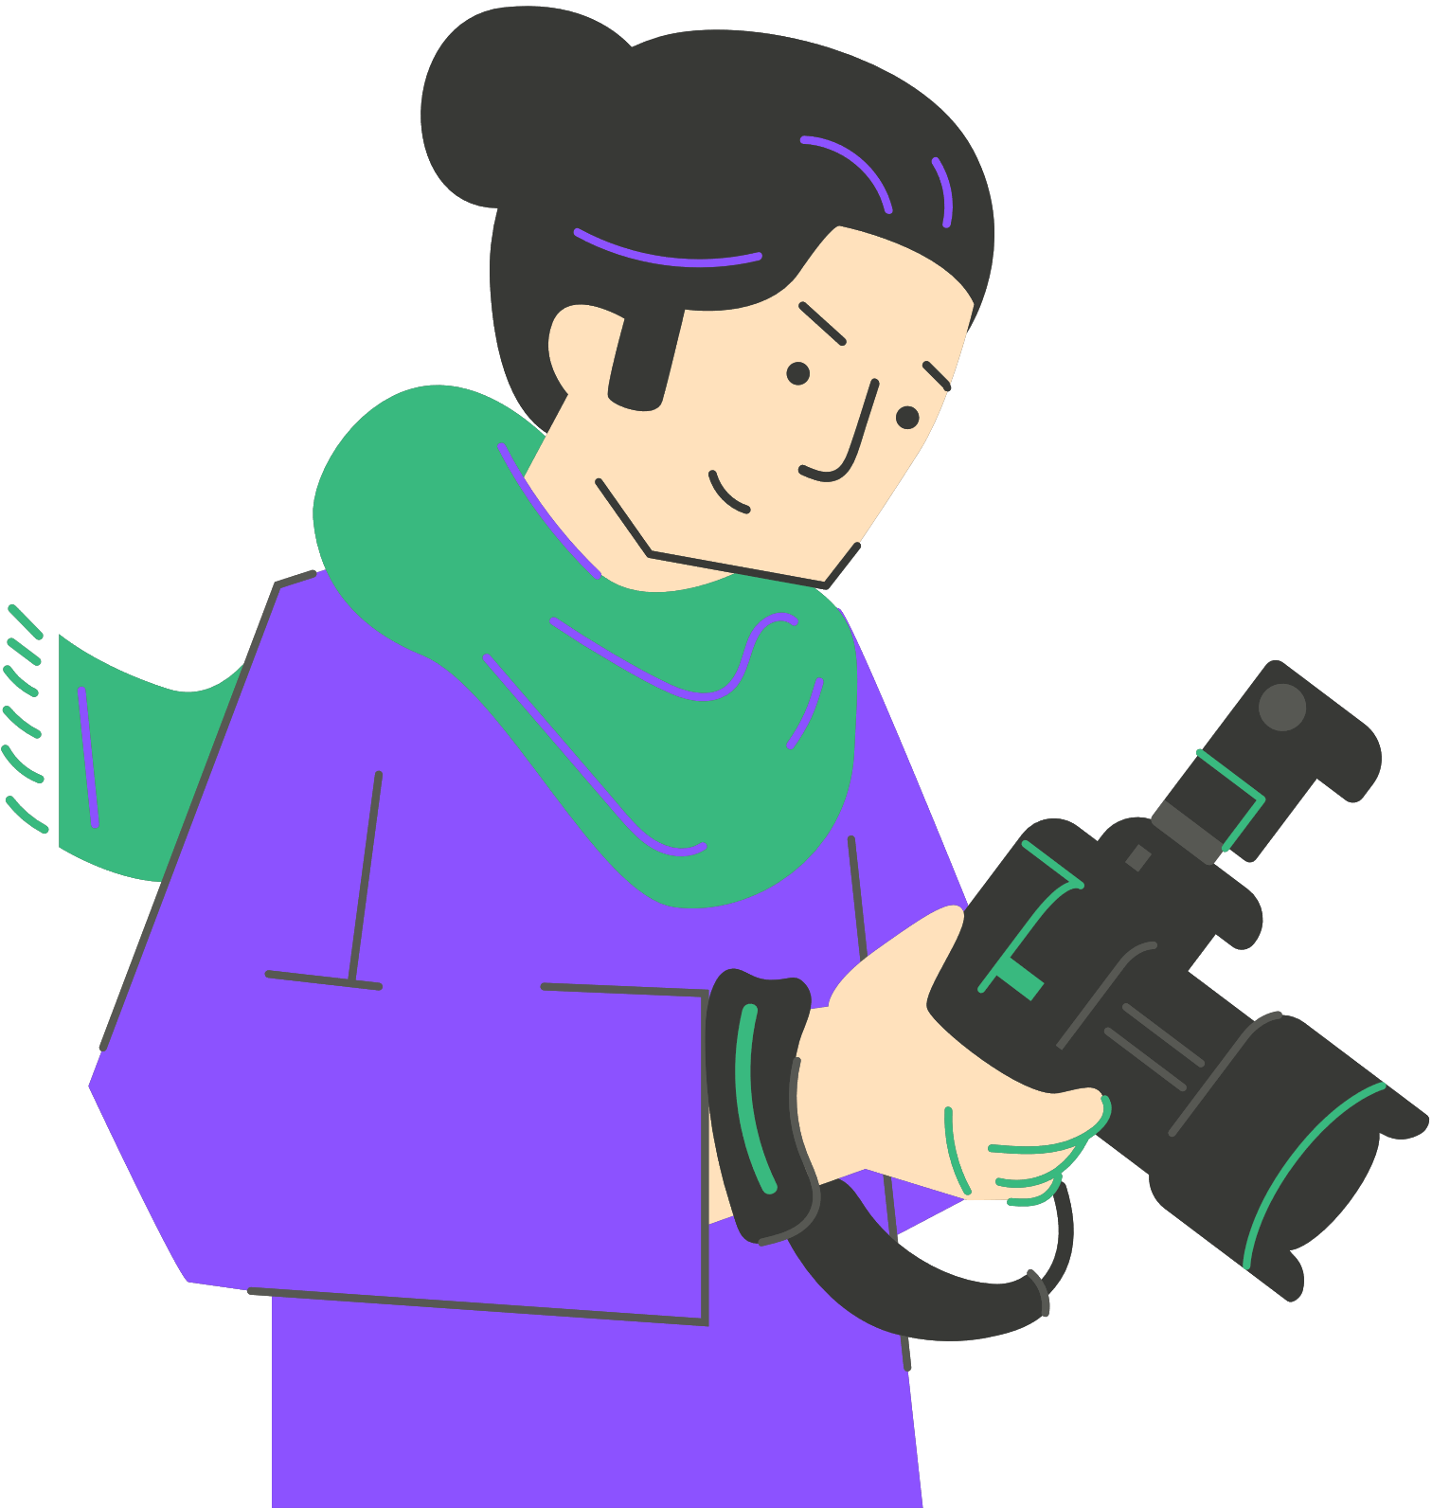
Story structure for visual narratives
part 1
Freytag’s Pyramid:
Exposition
Rising action
Climax
Falling action
Resolution
Notes:
It is important to engage with schemes and story structures that work as models to organize visual narratives in terms of understanding , perceιving and also producing. Freytag’s Pyramid was developed by Gustav Freytag, a 19th-century German playwright, novelist, and literary critic, best known for his research around narrative structure analysis. He breaks stories into five parts that reflect the emotional development of the work. Exposition is the beginning of the story, rising action is the moment a tension or change happens, climax as the word indicates is the pick of what happens, falling action shows the impact of what happened, resolution is the end of the story which includes how things will continue to be but also morals, decisions, imagination. This model can be observed often in cinema, in photography, in video games, in classical or other music also.

Slide 14
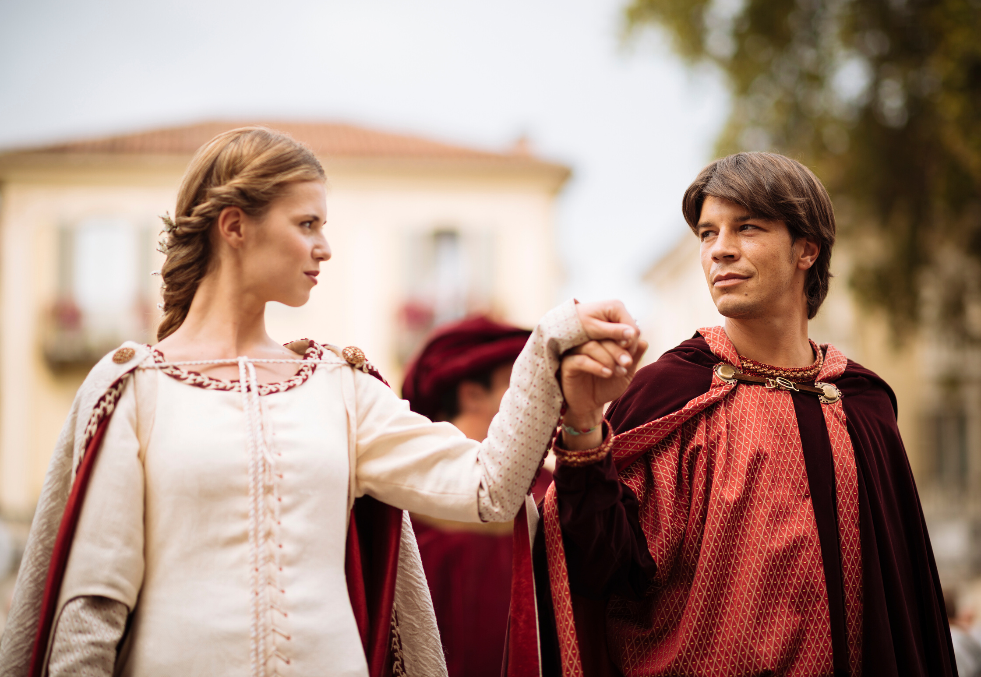
Which famous story is this one?
Introducing two families
A boy and a girl meet, fall in love, and marry, despite the families’ disagreement
Two murders make it complex for the boy, leading to his banishment
The girl fakes her death to avoid marrying someone else
The boy and the girl kill themselves
Notes:
Take some time to think which famous story is here ( Romeo and Juliet). Study the pyramid. Exposition (introducing the families, the Montagues and Capulets). Rising Action. (Romeo and Juliet meet, fall in love, and marry, despite the families disagree). Climax (Two murders make it complex or Romeo , leading to his banishment). Falling Action (Juliet fakes her death to avoid marrying Paris, Romeo doesn't receive the message). Resolution (Romeo and Juliet kill themselves)
Even summarized in bullet points, you can feel the structure—setup, complications building, crisis, tragic resolution. This same structure can guide a 5-photo story about the water cycle or a video about a historical event
It is important to engage with schemes and story structures that work as models to organize visual narratives in terms of understanding , perceving and also producing. Freytag’s Pyramid was developed by Gustav Freytag, a 19th-century German novelisto to analyse narratives. He breaks stories into five parts that reflect the emotional development of the work. Exposition is the beginning of the story, rising action is the moment a tension or change happens, climax as the word inticates is the pick of what happens, falling action shows the impakt of what happened, resolution is the end of the story which includes how things will continue to be but also morals, decisions, imagination. This model can be observed often in cinema, in photography, in videogames, in classical or other music also.

Slide 15
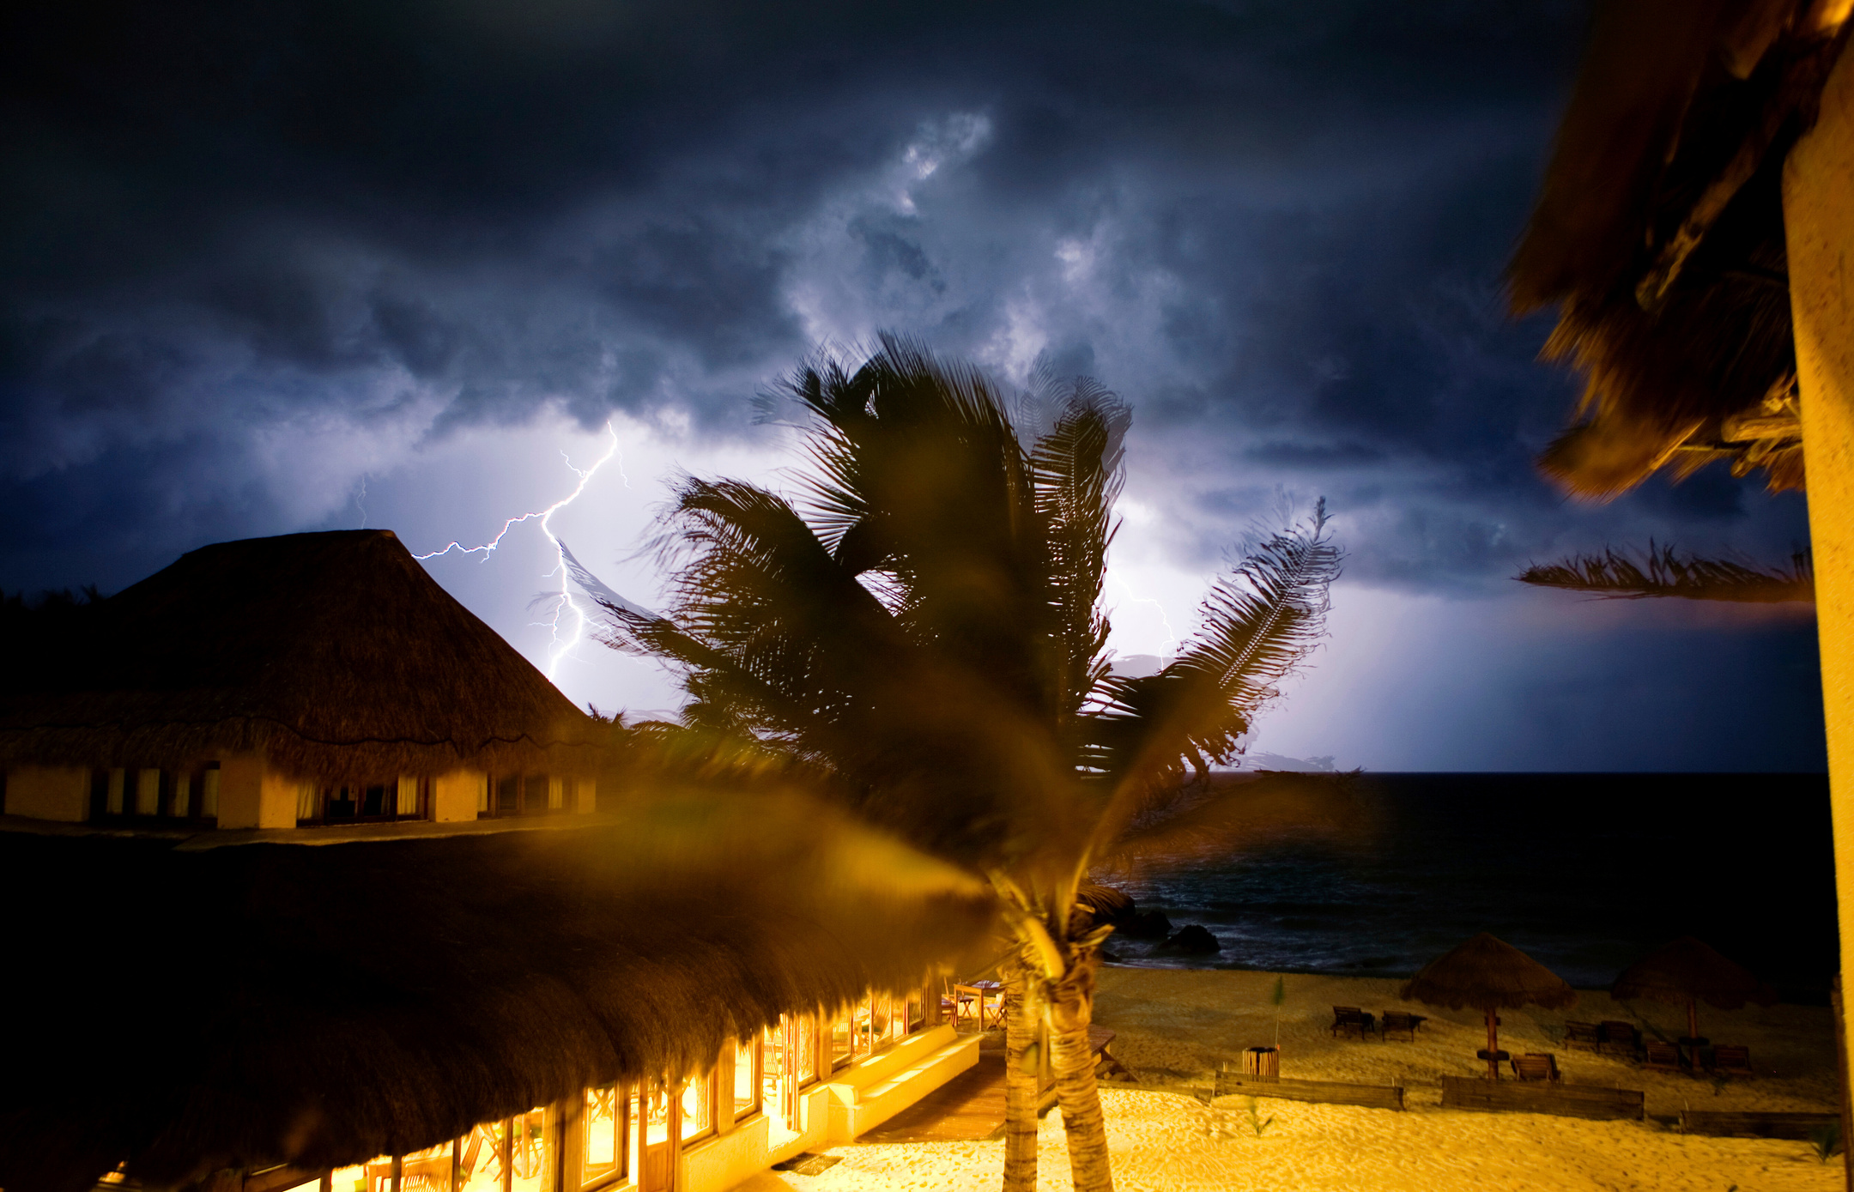
Story structure for visual narratives
part 2:
To break the rules you need to know them first
Models like the pyramid are critical to get a solid basis but,
Escaping models is also welcome as long as you know them
New media everytime create new narrative conditions and environments.
Digital media are famous for breaking the continuity of narratives.
Notes:
As french philosopher who talks so deeply about photography, Roland Barthes said, the forms of narrative in the world are infinite, and this is liberating to our expression. It is important to understand this, and particularly how the everytime “new”media create different and alternative story structuring possibilities. Look at the facebook or instagram album . It is already offering an image sequence, you can play with it and make your own rules. Still, to break the rules you need to know them. Digital media are famous for breaking the continuity of narratives.Think of the hypertext, think of auviovisual narratives, think of collaborative digital narratives.
It is important to engage with schemes and story structures that work as models to organize visual narratives in terms of understanding , perceiving and also producing. Freytag’s Pyramid was developed by Gustav Freytag, a 19th-century German novelisto to analyse narratives. He breaks stories into five parts that reflect the emotional development of the work. Exposition is the beginning of the story, rising action is the moment a tension or change happens, climax as the word indicates is the pick of what happens, falling action shows the impact of what happened, resolution is the end of the story which includes how things will continue to be but also morals, decisions, imagination. This model can be observed often in cinema, in photography, in video games, in classical or other music also.

Slide 16


Practical Activity: A “classic” structure
Watch the video called “The Underdogs”
Identify the elements of the story structure. How long does it take for the different parts of the story to unfold?
How does this story make you feel?
Notes:
“The Underdogs” is the first installment of an Apple advertising campaign showcasing workplace collaboration through its product ecosystem. It is based on dramatization to get through its message.
(recap for the teacher: the film worked because it had a character you could root for, music that built tension, themes of persistence and teamwork. Authenticity matters—even fictional stories need emotional truth. )

Slide 17
How Stories Create Emotional Connection
Personal perspective: Each story uses an individual voice or identifiable character.
Emotional triggers: Music, tone of voice, visuals, and pacing provoke empathy.
Relatable themes: Freedom (Walls), human dignity (Renia Spiegel).
Authenticity: True or semi-true experiences make audiences feel rather than just understand.
Shared reflection: Stories invite viewers to compare their own emotions and values.
Notes:
Let’s see how all these elements are present in real world examples of digital storytelling, creating powerfull stories and also powerful experiences.

Slide 18

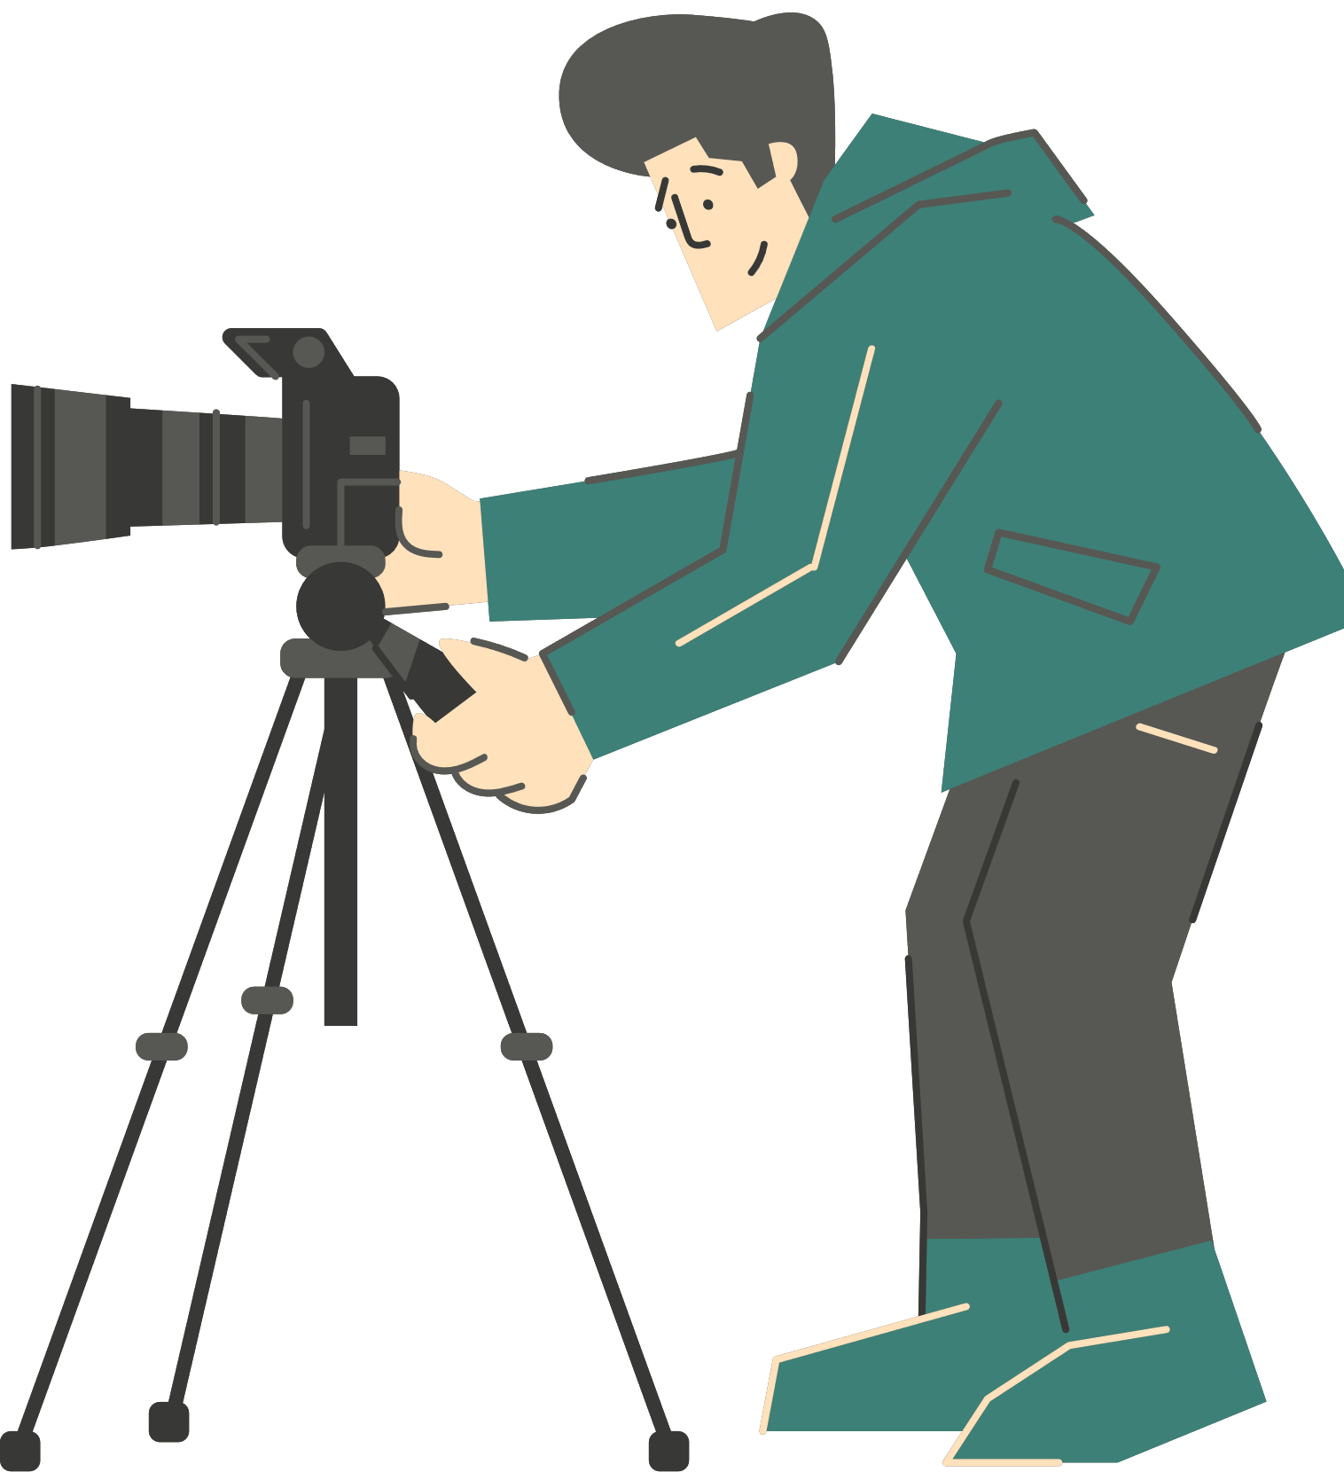
Real-World Examples of Digital Storytelling
The Diary of Renia Spiegel
Short films from the Galicia Jewish Museum that transform a real diary into a human-rights learning tool.
Shows how personal stories create empathy and bring history to life.
Notes:
"The Diary of Renia Spiegel – Digital Storytelling and Education for Human Rights" , is a series of short films from Galicia Jewish Museum in cooperation with the Education and Art Foundation,
The series emphasize education and engagement, showing that storytelling must be rooted in a clear learning or social goal, adapting storytelling style to educational settings, making them digestible and engaging for younger learners.
It touches deeply by linking personal tragedy with broader lessons on human rights. One can see that even in the form of the films, which have a strong narrative, but blend history with personal diaries.
This is a powerful example of digital storytelling for education. Instead of teaching the Holocaust through statistics, this short film uses one girl's diary. We connect with Renia as a person—her hopes, fears, daily life. History becomes human.
One way of creating emotional connection in a story with a clear educational purpose is to take abstract concepts and make them personal.

Slide 19
Real-World Examples of Digital Storytelling
Equipo Planeta
A TV program for children combining real people, puppets, and animation.
Demonstrates how storytelling can simplify complex topics like sustainability through play and imagination.
Notes:
Clarity and simplicity are critical in telling stories.
Equipo Planeta, is a tv program that combines real persons, puppets, and animations, to a mix of entertainment and educational content. Each episode has a clear theme and never loses its focus on stimulating creativity in children.
For younger students especially, imagination and play unlock understanding.
Mixed-media stories with photos, drawings, and narration.

Slide 20
Real-World Examples of Digital Storytelling
Walls
An animated digital story by Greek high-school students inspired by C.P. Cavafy’s poem.
Illustrates how art and poetry can be used to discuss inclusion, borders, and belonging.
Notes:
This is a video created by students, and is used in an educational context, as part of a litterature class, using texts that are in the official curriculum.
This one's especially relevant—created by students. They took a classic poem and interpreted it through animation to explore contemporary issues of borders and belonging.
This is what's possible when you give students creative tools and meaningful topics. The technical skill develops through practice; the important part is having something to say.

Slide 21
Practical Activity: Brainstorm Your Story
Task: Design a digital story for your classroom
Think of a school subject (e.g. Science, Literature, History, Geography, Art).
Brainstorm a topic that could become a digital story — something that students could photograph, narrate, or visualize creatively.
In small groups, discuss:
What message would the story convey?
What emotions should it evoke?
What images or voices could express it?
4. Each group shares one sentence starting with: “Our story would
show students that…”
Notes:
(Activity can be done out of sequence, as a homework, etc)
Now it's your turn.
Form groups of 3-4 people . Be specific and practical—think about resources available in your school. Don't worry about perfection; focus on the core idea. For example: "Our story would show students that photosynthesis is happening all around them by photographing plants in different light conditions throughout the day."

Slide 22





Thank you!
Funded by the European Union. Views and opinions expressed are however those of the author(s) only and do not necessarily reflect those of the European Union or the European Education and Culture Executive Agency (EACEA). Neither the European Union nor EACEA can be held responsible for them.
Creative Commons licence (either free or 4.0 share alike)

Slide 23


References and bibliography
Sontag, S. (1977). On Photography. Farrar, Straus and Giroux.
Barthes, R. (1981). Camera Lucida: Reflections on Photography. Hill and Wang.
Project Zero Harvard (n.d) Pzs thinking routines toolbox. Available at: https://pz.harvard.edu/thinking-routines (Accessed: 19-6-2025).
Lambert, J., & Hessler, B. (2008). Digital Storytelling: Capturing Lives, Creating Community. Routledge.
McCurry, S. (1984) Sharbat Gula (Afghan Girl) [online photograph]. Available at: https://en.wikipedia.org/wiki/Afghan_Girl#/media/File:Sharbat_Gula.jpg (Accessed: 30 June 2025).
Wegman, W. (1970), Falling Glass. [online photograph]. Available at: https://bpb-us-e1.wpmucdn.com/you.stonybrook.edu/dist/0/2212/files/2017/09/%EC%8A%A4%ED%81%AC%EB%A6%B0%EC%83%B755-2beh3rw.pngAccessed: 30 June 2025)

Slide 24








THE SHOOT TEAM

