Slide 1



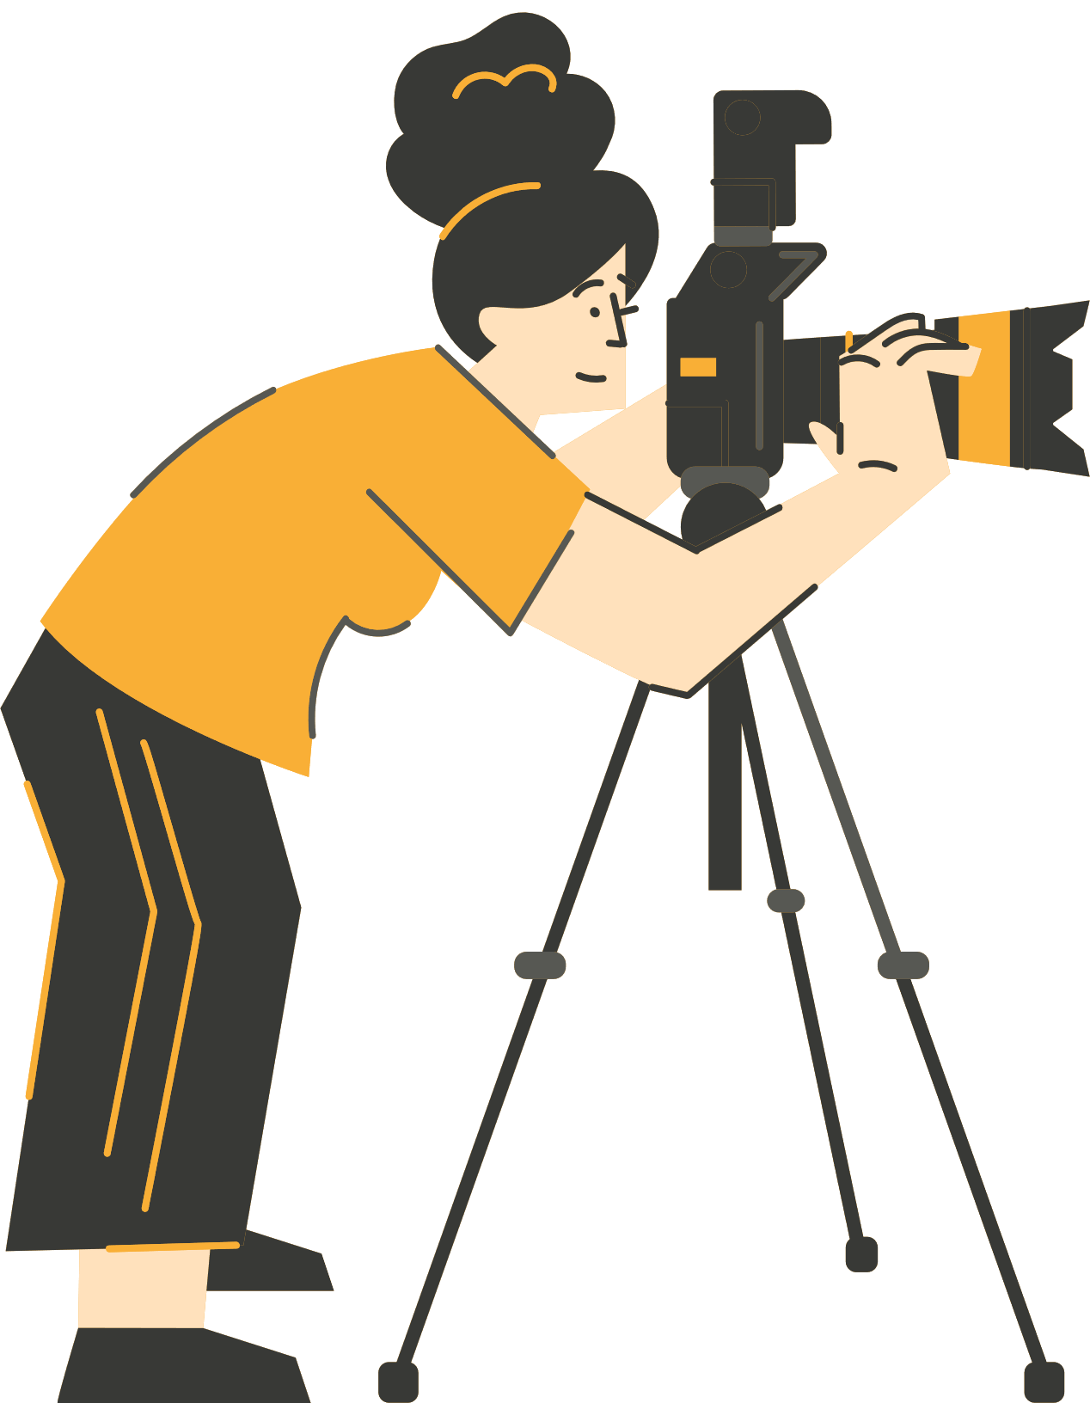




CONTAR HISTORIAS A TRAVÉS DE LA FOTOGRAFÍA DIGITAL
WP3 Metodología Producir y Compartir tu Historia Fotográfica Digital
Financiado por la Unión Europea. Sin embargo, los puntos de vista y las opiniones expresadas son únicamente los del autor o autores y no reflejan necesariamente los de la Unión Europea o de la Agencia Ejecutiva Europea de Educación y Cultura (EACEA). Ni la Unión Europea ni la EACEA pueden ser consideradas responsables de ellos.

Slide 2
CONTENIDOS:
Webinar 3:
Producir y Compartir tu Historia Fotográfica Digital
Técnicas de Producción (Toma y Edición)
Agregar Texto,
Leyendas y Audio
Agregar material extra de repositorios digitales
Ética y Ciudadanía Digital
Plataformas para Compartir
Evaluación y Reflexión
Referencias y bibliografía
Notes:
Today is about finishing your stories and releasing them responsibly. We'll work seeing several practical tools, we will discuss ethics related to image use, and explore sharing options and platforms.

Slide 3
LA METODOLOGÍA SHOOT PARA CONTAR HISTORIAS
Esta metodología presenta un enfoque innovador para la enseñanza al integrar la narración digital a través de la fotografía. Arraigada en la neurociencia, la narración fomenta las conexiones emocionales, haciendo que la información sea más accesible y memorable.
Aborda los desafíos que enfrentan los estudiantes desmotivados y aquellos con dificultades de aprendizaje al aprovechar las tecnologías contemporáneas para crear un entorno de aprendizaje atractivo e inclusivo.
La narración aumenta la participación, la creatividad y la comprensión en todas las asignaturas curriculares, al tiempo que se adapta a las diversas necesidades de aprendizaje, incluidos los estudiantes con dificultades de aprendizaje.

Slide 4



Webinar 3: Producir y Compartir tu Historia Fotográfica Digital
Notes:
Hi class, for the last session of our course! Today let's explore how to create meaningful digital photo stories, their production techniques and get to think about the ethics around creating and sharing.

Slide 5
Hoy vamos a examinar las técnicas de producción, la ética, cómo compartir y reflexionar sobre nuestras historias digitales
Notes:
So far we worked with photos, photo stories, storyboards, have been studying images and their world. Let’s develop and share our photo stories today! Here is where planning becomes reality!

Slide 6


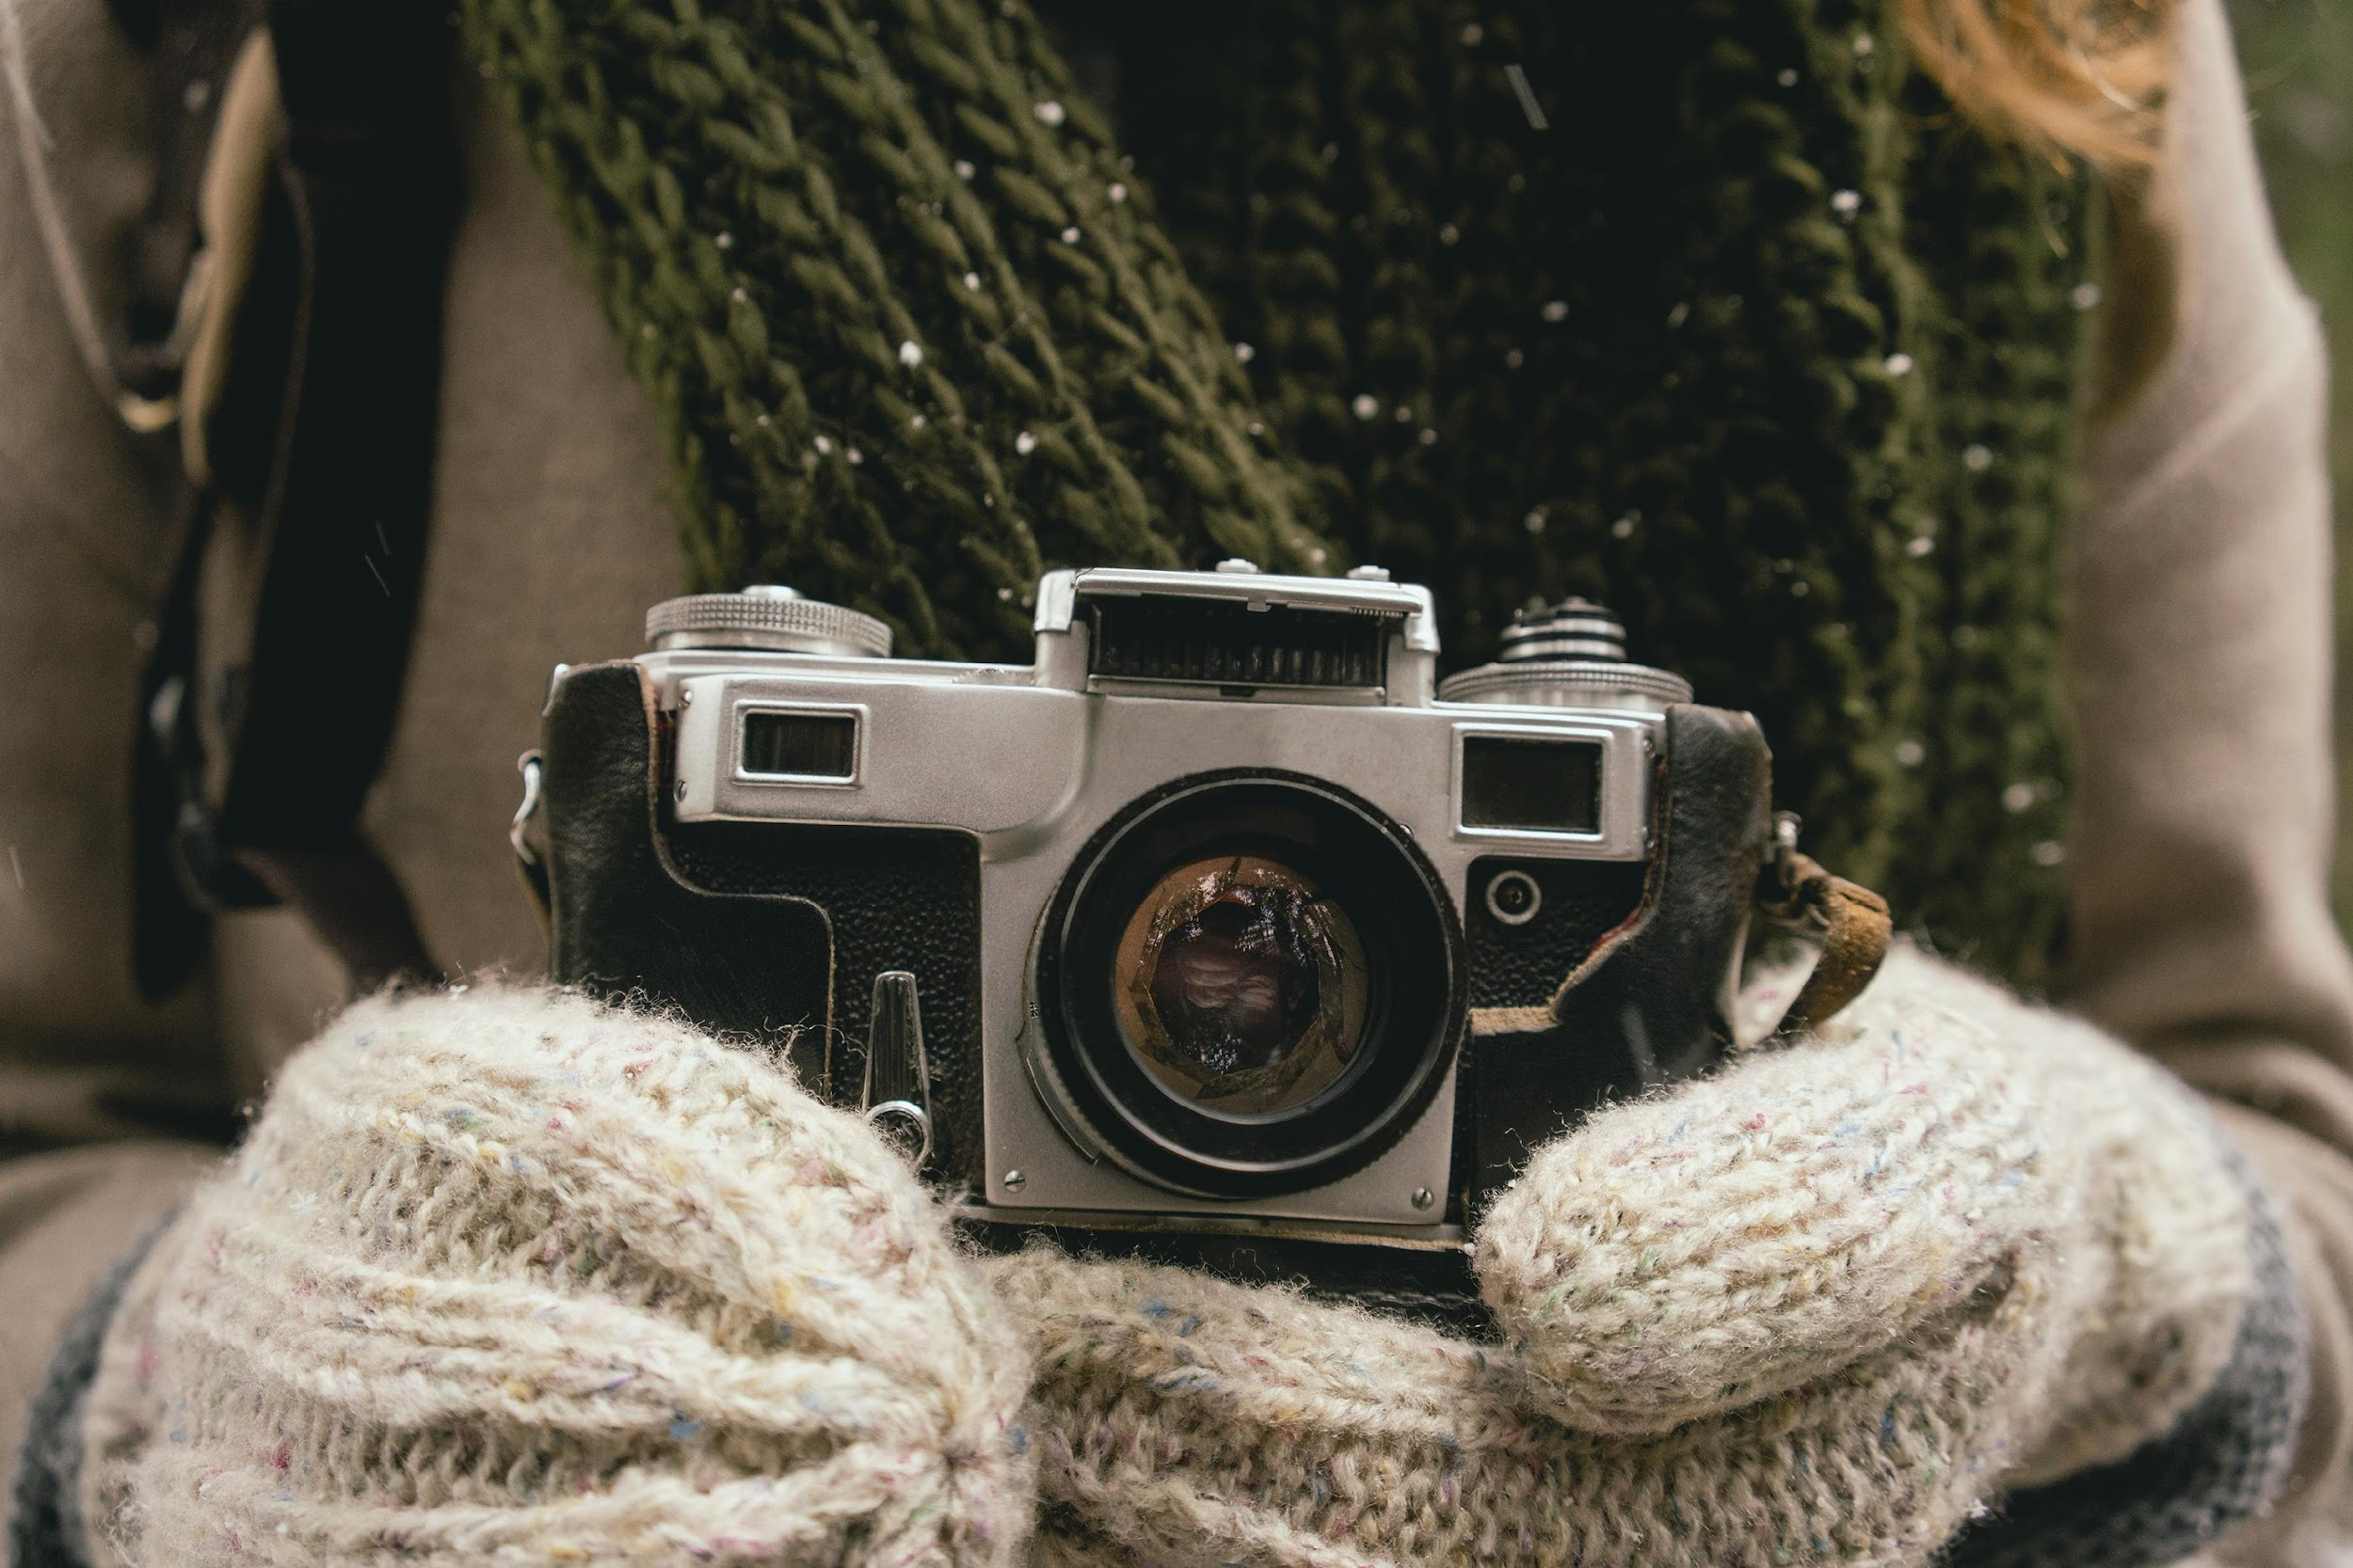
Desde la producción hasta la publicación:
Disparar (Shoot) → Capturar con intención
Editar (Edit) → Seleccionar y refinar, secuenciar, recortar
Mejorar (Enhance) → Agregar texto, audio, material de archivo
Considerar la ética → Respeto y responsabilidad
Compartir (Share) → Elegir plataformas y audiencia
Evaluar (Evaluate) → Reflexionar y mejorar
Notes:
This is the production sequence. Each part is done as a continuation of the previous one and demand skills, which we are developing. From shooting images to editing and to adding multimedia elements there are tricks, techniques, tips, documentation you can find online for anything technical you don't know. Let's explore some shooting tips now.

Slide 7
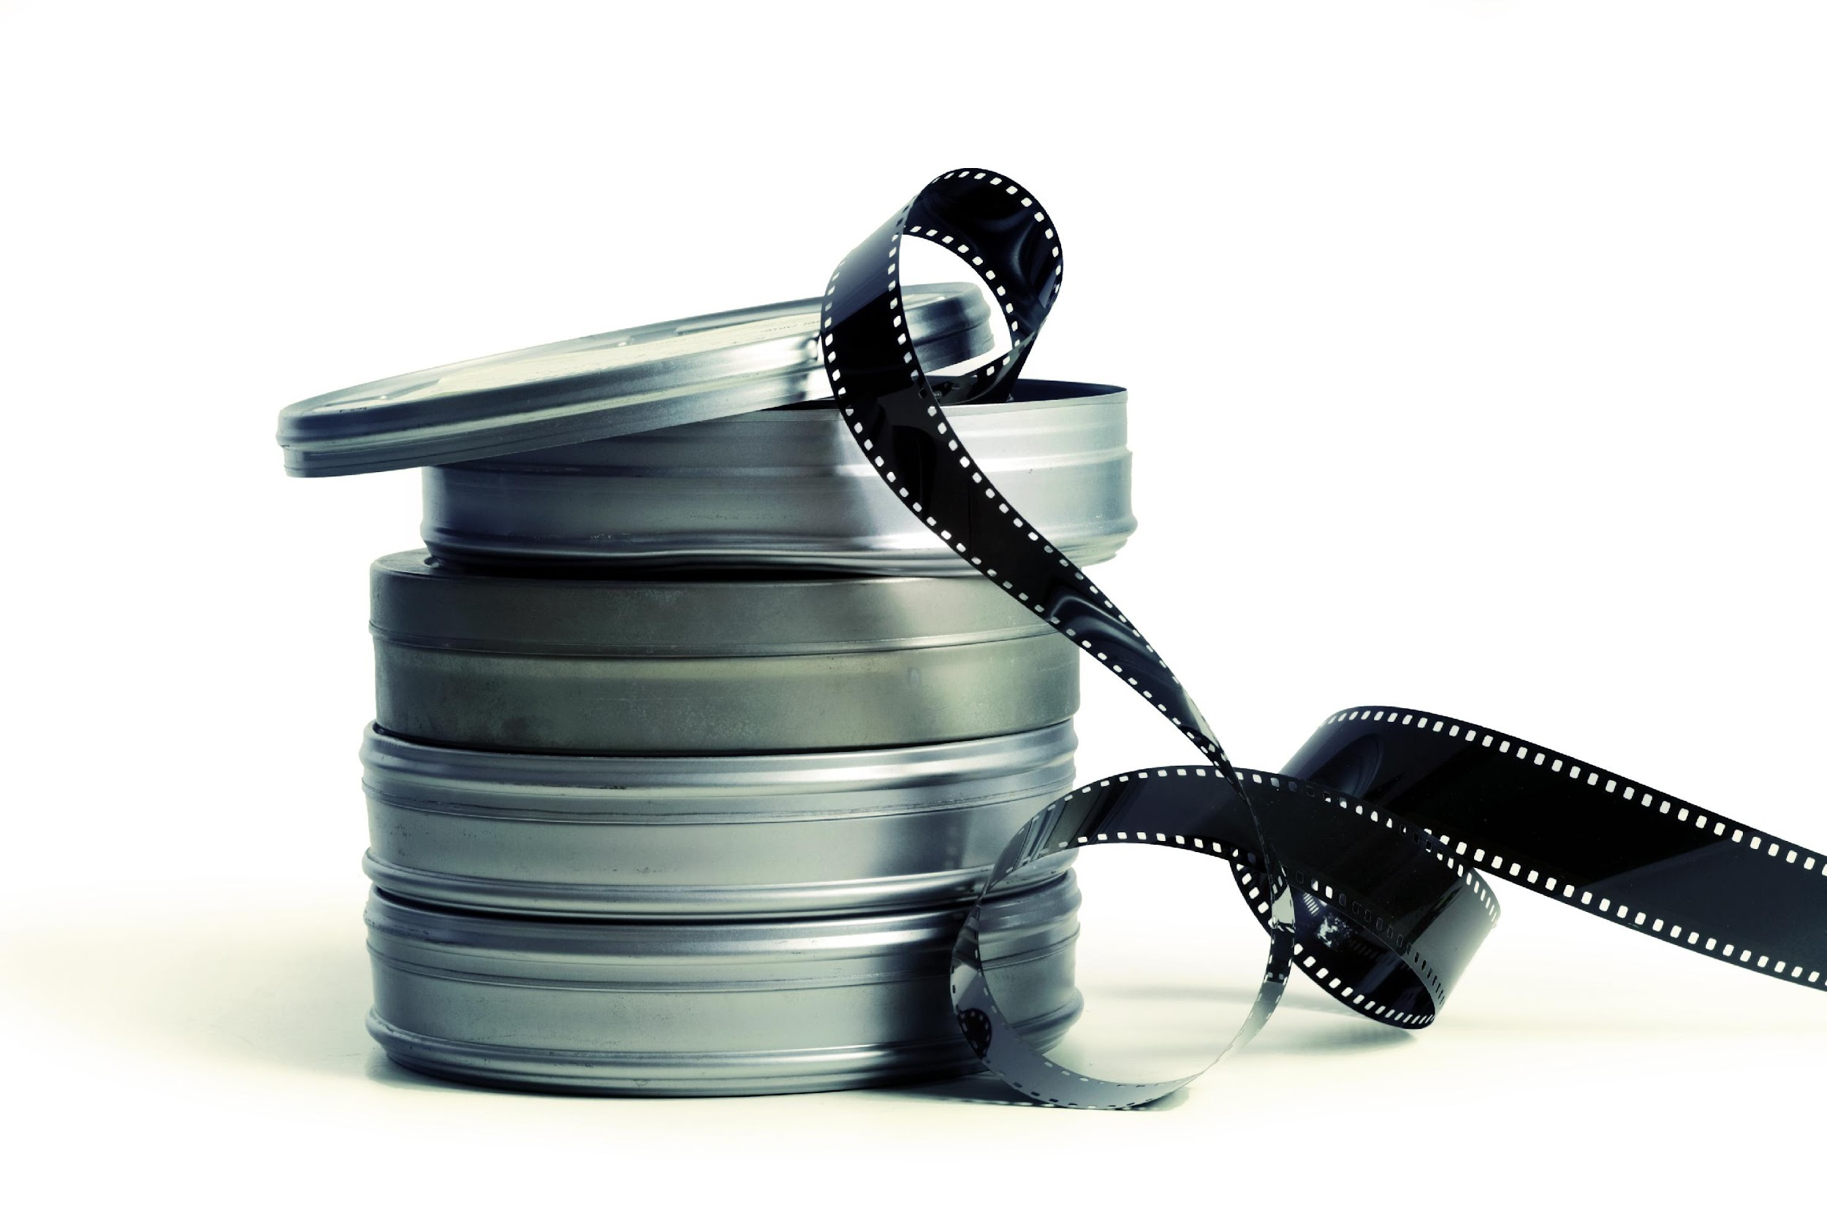
Técnicas de Producción - Consejos de toma
Iluminación
Enfoque y Claridad
Momentos Auténticos
Notes:
Let's talk about actually shooting your story. These are fundamental principles that separate snapshots from storytelling images. We have seen several of these elements before, but let’s have a look at them once more.

Slide 8
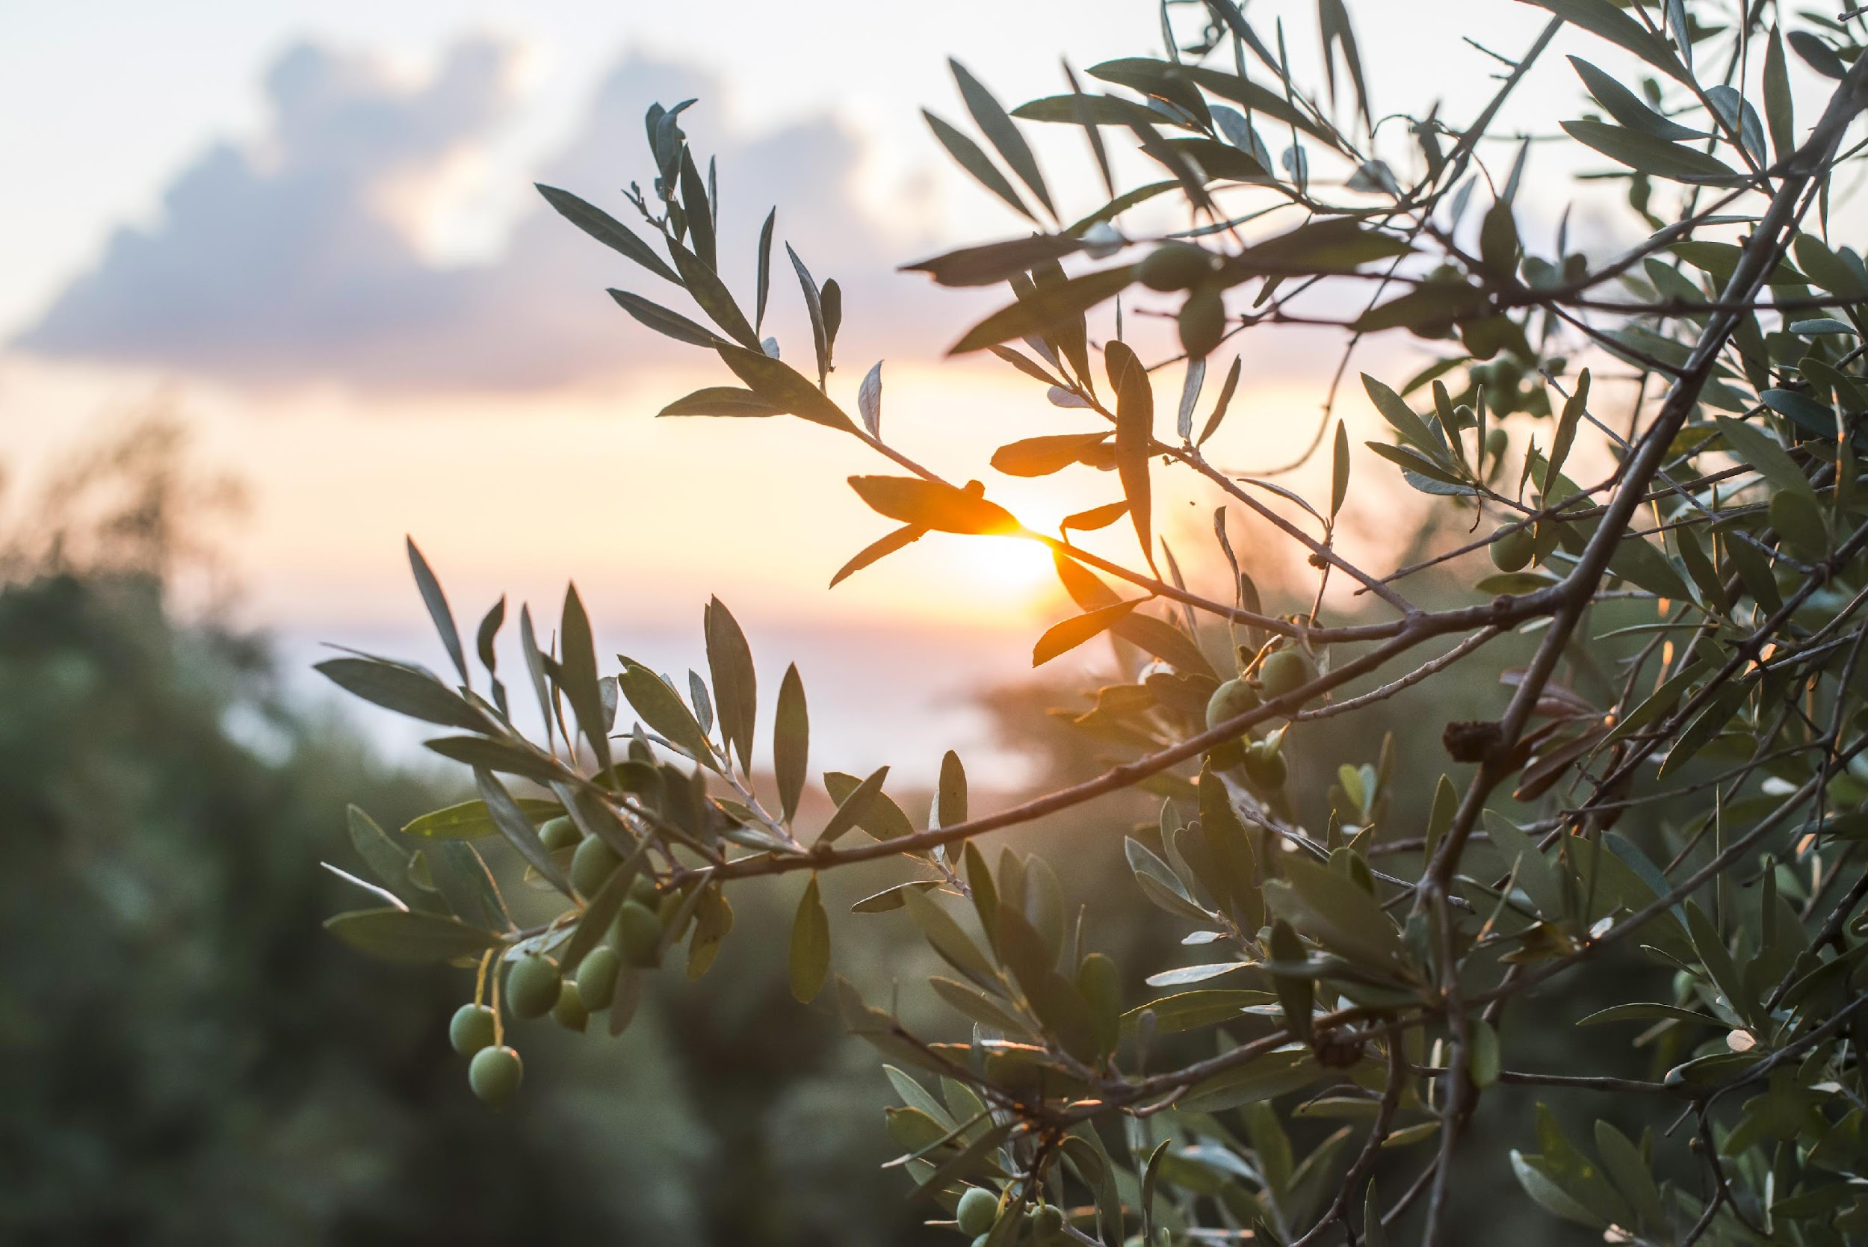
1. ILUMINACIÓN
Usar luz natural cuando sea posible
Evitar sombras duras y la sobreexposición a menos que sea una elección consciente
Hora dorada (amanecer/atardecer) = luz hermosa y cálida
Días nublados = luz uniforme y suave (excelente para retratos)
Notes:
LIGHTING is your primary tool. Natural light is almost always better than flash, which can look harsh and artificial.
If you're shooting indoors, position your subject near a window.
Outside, early morning or late afternoon gives you that golden, directional light.
Midday sun is harsh—if that's when you must shoot, find shade or use it intentionally for drama.

Slide 9

2. ENFOQUE Y CLARIDAD
Mantener al sujeto nítido y claro
Usar la función de enfoque de la cámara intencionalmente
El desenfoque puede ser artístico (poca profundidad de campo) pero debe ser intencional
Notes:
FOCUS matters enormously. Your camera (or phone) focuses on what you tap. Be intentional. In a portrait, focus on the eyes. In an action shot, focus on your subject. Modern phones can create background blur (portrait mode)—this is great for isolating subjects, but use it purposefully.
Put your attention to your story’s main elements.

Slide 10

3. MOMENTOS AUTÉNTICOS
Capturar expresiones y acciones genuinas
Lo cándido o espontáneo a menudo supera a lo posado
¡La paciencia es clave! Esperar el “momento decisivo”
Notes:
AUTHENTIC MOMENTS require patience. Instead of saying "smile at the camera," try capturing people doing something—a student concentrating on an experiment, someone laughing at a genuine moment.
Photographer Henri Cartier-Bresson called it the "decisive moment"—that instant when composition, light, and action align. Sometimes you have to wait for it.
Pro tip: Take multiple shots. You can't reshoot moments, so capture variations. You'll choose the best in editing.
Candid shots (pictures that capture natural and spontaneous moments without posing ) often tell more authentic stories because they capture real emotion and action and an event in the happening. We worked before around the theme of authenticity in storytelling, remember what we said, it's important to take you’re your truth, your message, your observation, your subjectivity.

Slide 11

Conceptos Básicos de Edición - El Proceso de Selección
Elegir imágenes que comuniquen claramente el mensaje
Evitar fotos redundantes (a menos que la repetición sirva a un propósito)
Eliminar imágenes que distraigan o confundan
Preguntas a hacer:
¿Esta imagen hace avanzar mi historia?
¿Qué emoción o información transmite?
¿Es visualmente fuerte (composición, luz, claridad)?
¿Funciona con las otras imágenes como una secuencia?
Notes:
This is where many people struggle—choosing which images to keep. You might shoot 50 photos but use only 5-10 in your final story. That's normal and good.
Be ruthless. Every image must earn its. Pick photos that contribute to the story flow, avoid confusion or repetition that is caused by redundant or unclear photos unless it’s a conscious choice.
If an image is beautiful but doesn't advance your story, cut it. If you have three similar shots, choose the strongest one.
Look for visual variety in your sequence: wide shots for context, close-ups for emotion, different angles and perspectives. A story that's all close-ups or all wide shots gets monotonous.
Think like a film editor: What's the minimum needed to tell your story powerfully? Less is often more.

Slide 12
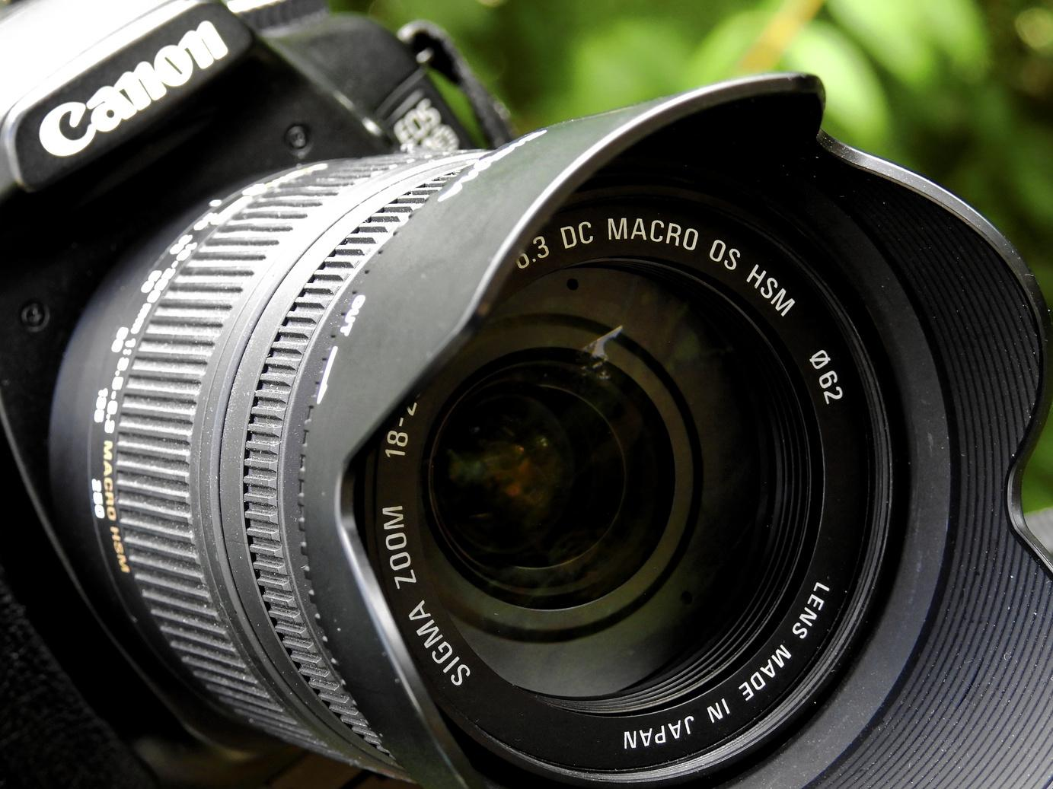
Conceptos Básicos de Edición - Recorte (Cropping) y Secuenciación
Recorte (Cropping)
Centrar la atención eliminando información que distrae en los bordes
Mejorar la composición (recordar la regla de los tercios)
Cambiar la relación de aspecto (horizontal, vertical, cuadrado)
No recortar en exceso, se pierde calidad
Notes:
Once you've selected images, you refine them through cropping and sequencing.
You are familiar with CROPPING as a method but it’s important to see it a little bit conceptually also not only technically.
Maybe there's a distracting sign in the background—crop it out.
Maybe your subject is too centered—crop using rule of thirds. Phone apps and free software make this easy. But be careful: aggressive cropping reduces image quality.
Crop thoughtfully, not excessively.
Tip: always keep the original photo, crop a copy!

Slide 13
Conceptos Básicos de Edición - Recorte y Secuenciación (cont.)
Secuenciación
Organizar las imágenes en un orden narrativo significativo (cronológico, arco emocional, progresión conceptual)
Crear un ritmo visual
Probar antes de finalizar
Herramientas gratuitas: GIMP, Pixlr, Photoshop (si está disponible) o aplicaciones de edición de teléfono
Herramientas gratis: GIMP, Pixlr, Photoshop (if available), or phone editing apps
Notes:
SEQUENCING is where storytelling really happens, as it creates a narrative flow, designing a navigation through the story. The same five images in different orders tell different stories. This is where a storyboard can be helpful!
Try this experiment: lay out your images and rearrange them. How does starting with a wide establishing shot versus a dramatic close-up change the narrative?
Think about emotional pacing. If every image is intense, your audience gets exhausted. If every image is quiet, they get bored. Create rhythm—build tension, offer release. Show the context, then zoom to detail. Start with mystery, then reveal.
Classic sequences often follow: establish setting → introduce character → show conflict/action → resolution/reflection. But you can break this pattern intentionally once you understand it.
Digital tools help: Most slideshow or video editors let you drag images around. Experiment. Trust your instincts. Does this order feel right? Does it tell the story you want?
As a small exercise, download images from people of the web and crop their faces only in Gimp or Pixlr or Photoshop.

Slide 14

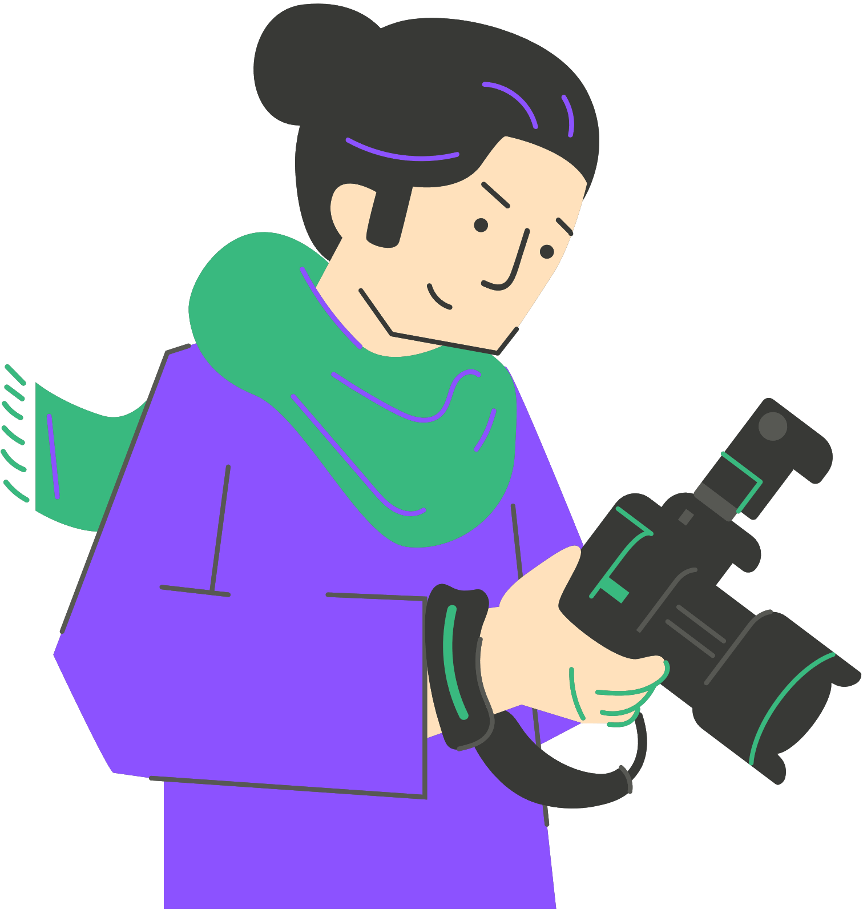
Agregar Texto, Leyendas y Audio
Texto y leyendas
Explicar, mejorar o jugar con el significado
Mantener el texto breve, las imágenes son lo más importante aquí
Las leyendas pueden proporcionar contexto, hacer preguntas, añadir ironía
Elegir fuentes legibles y una colocación apropiada
Notes:
Now we're adding layers beyond the images themselves. Multimodal elements like captions or audio add depth and context make your story more engaging and accessible
TEXT should serve the images, not overpower them. Text as caption can be creative, it can be literal or not, it can even say something different than what the image says. For example, it can create meaning through juxtaposition (an image of pollution with the caption "Progress?"). Bad captions simply describe what we can already see ("A sad child")
Keep captions short. If you need a paragraph to explain an image, maybe you need a different image.
Make sure the text is easy and quick to read, that it does not disappear in the background, and of course that you do not make any spelling errors!!!

Slide 15
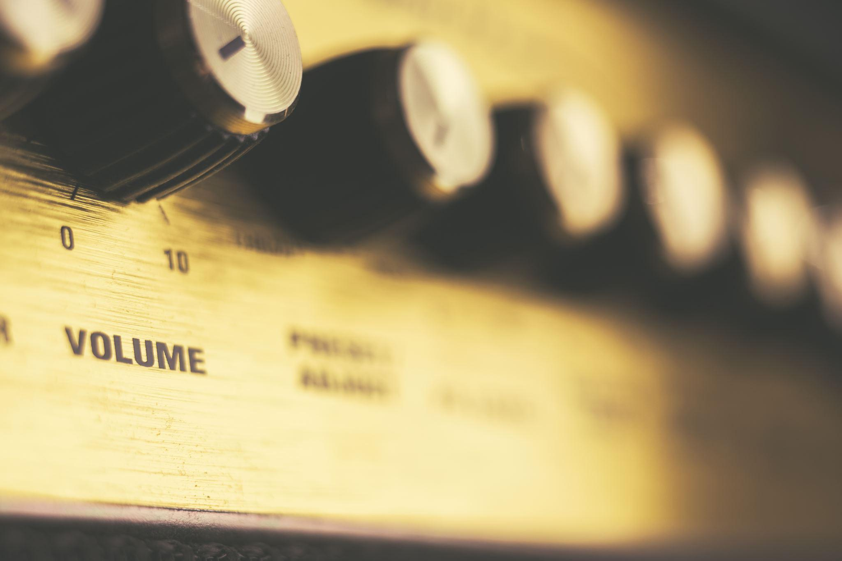
Agregar Texto, Leyendas y Audio (cont.)
Audio
Narración en voz en off: Tu voz guiando la historia
Sonido ambiental: Atmósfera (ruido de aula, sonidos de la naturaleza, calles de la ciudad)
Música: Establece el estado de ánimo y la emoción
El audio debe complementar, no competir con, los elementos visuales
Equilibrio: Dejar respirar a las imágenes. No sobre-explicar
Notes:
Mixing visual with audio comes on the basis of audiovisual artistic practices.
AUDIO transforms static images into immersive experiences. Your voice-over can provide context, express emotion, or guide interpretation.
Ambient sound creates atmosphere—the sound of rain makes weather photos more powerful. Music sets emotional tone instantly.
But be careful: Audio can overwhelm. If your music is too loud or dramatic, audiences focus on the music instead of the story. If your narration is constant, images don't have space to speak. Think about silence, too—strategic quiet moments can be powerful.
Try your photostories with different sounds and you will be surprised. For example, a photostory about a dog running happy in the park and playing with a ball, will feel different if you blend it with a piece of instrumental music, or house music, or just sounds from the park. Each of this is a different story in the end.
Pro tip: Write your script, then cut it by 30%. Say only what's essential. Let your images do the heavy lifting

Slide 16

Agregar material de repositorios digitales
¿Por qué utilizar archivos digitales?
Conectar tu historia a una historia y cultura más amplias
Agregar materiales que no podrías crear tú mismo (fotos históricas, documentos, obras de arte)
Preservar el patrimonio cultural de forma creativa dándole un nuevo contexto
Mejorar la credibilidad y la profundidad
Qué puedes usar:
Fotografías y documentos históricos
Arte e ilustraciones
Grabaciones de audio y música
Textos y literatura
Clips de vídeo
Notes:
Digital archives are treasure for storytellers. Imagine creating a story about your city's history—you can incorporate actual historical photographs alongside your contemporary ones, showing change over time. Or a story about poetry—include artwork from the era it was written.
This serves multiple purposes. Artistically, it adds layers and resonance. Your personal photos gain depth when placed in dialogue with historical materials.
Educationally, it connects your story to broader cultural heritage.
Socially, it keeps archives alive—these materials exist to be used, shared, reinterpreted.
But—and this is crucial—you can only use materials that are openly licensed or in the public domain. We'll discuss this more in the ethics section, but the archives we will see in the next slide contain materials you CAN legally use.
Using archives isn't about replacing your work with others'. It's about enrichment. Maybe your story about migration includes your photos of students from different countries alongside historical photographs. That juxtaposition creates meaning neither could achieve alone.

Slide 17

Archivos y Recursos Digitales Clave
Principales repositorios (todos con licencia abierta): Archivos generales:
Europeana.org – Patrimonio cultural europeo (+50 millones de elementos)
Archive.org - Internet Archive (libros, películas, música, software)
Euscreen.eu - Archivos de televisión europeos
Proyectos de reutilización creativa:
Archive to Alive - Un proyecto escolar Erasmus que utiliza Archivos
Europeana gif it up - Crear GIFs a partir de películas de archivo
Notes:
According to French philosopher Jacques Derrida, technology has not only changed the archiving process, but also what is being archived. This means we archive so much that maybe its too much. But at the same time they is a huge available pool of online content than can be creatively appropriated and reused. Some key repositories here, please explore them in groups and see how you can download material and reuse it.
Europeana is safeguarding european cultural heritage,
archive.org archives the web but also millions of books, dvds, videogames,
euscreen hosts audiovisual content in european level.
The "Archive to Alive" and "GIF It Up" projects show how students like you have creatively used these archives. Browse them for inspiration.

Slide 18
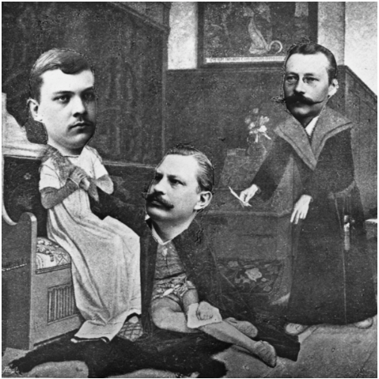
Cómo usar material de archivo
Buscar por tema, fecha o ubicación
Filtrar por materiales con licencia abierta (CC, dominio público)
Descargar y atribuir correctamente
Integrar cuidadosamente en tu narrativa
Notes:
Search "immigration," "industrial revolution," "daily life 1920s"—you'll find materials that can enhance almost any story.
Always check the license before using materials. Look for Creative Commons licenses or public domain. When in doubt, don't use it. And always attribute—give credit to the source
Note for teachers: For a more in depth analysis of the appropriation of digital archival content, theory, practise and connections with current AI tech, see the publication Archives in transit: From the world of libraries to artificial intelligence Digital teaching materials for Secondary Education teachers (listed in the end in the bibliography section)

Slide 19

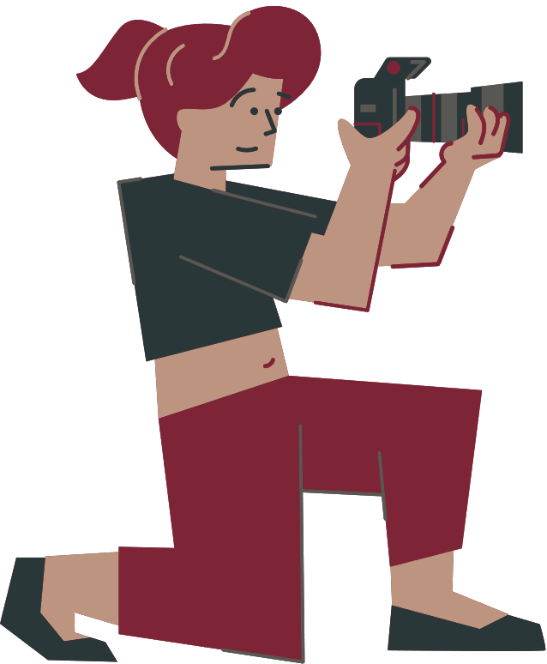

Herramientas para Crear y Editar el Contenido de tu Historia Digital:
🖼 Canva – crear diseños, añadir leyendas, música y animaciones.
🎧 Audacity – software gratuito para grabar y editar tu narración o efectos de sonido
🎞 WeVideo – editor de vídeo en la nube (características similares a Canva, línea de tiempo intuitiva).
💻 Clipchamp – editor de vídeo de Microsoft, integra texto, transiciones y audio.
🎬 VEV Design – editor visual basado en navegador para historias interactivas.
No te sientas abrumado: empieza con UNA herramienta
Notes:
Here's the practical toolkit question: What software do I use?
A general advice: Start simple. Don't try to master professional tools immediately.
CANVA is incredibly user-friendly and does almost everything you need—combines images, text, music, even basic animation. It's browser-based, so no installation needed. Many students find it perfect for digital stories.
GOOGLE SLIDES or POWERPOINT work surprisingly well for simple photo stories. Add your images, set slide timing to auto-advance, add narration or music, and export as a video. It's not fancy, but it's effective and you already know how to use it.
If you want more video-editing features, CLIPCHAMP (comes with Windows) or WEVIDEO (browser-based) are good next steps. They work like simplified versions of professional editors—you have a timeline, drag in clips, add transitions and text.
AUDACITY is the standard for recording voice-overs. It's free, works on any computer, and has everything you need for clean audio.
Here's the truth: The tool matters less than the story. Which means that you can use a simple tool and still create a very powerful story, or you can use a very sophisticated one to produce something mediocre.
Master one tool, then expand if needed. Don't let technology intimidate you—these tools are designed for beginners.

Slide 20

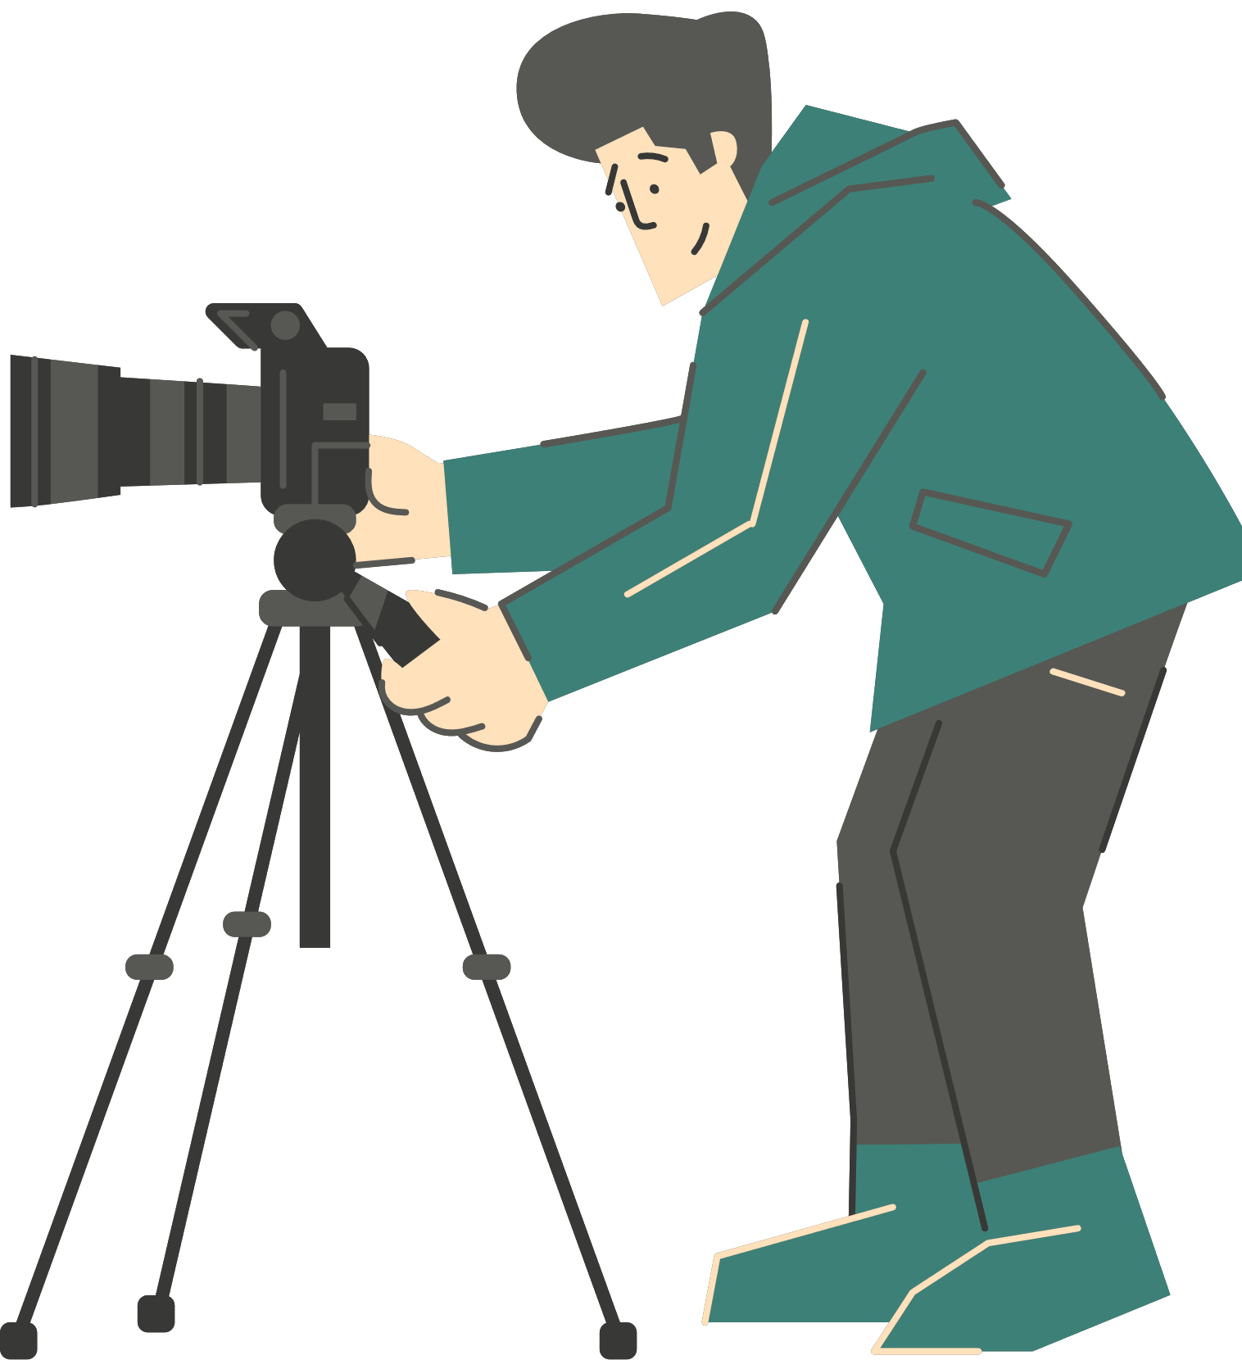
Integración de Voz e Imágenes en una Narrativa Cómo combinar voz y elementos visuales
Escribir un guion corto: 5–8 frases que expresen la emoción, no solo hechos.
Escribir como se habla, no como un ensayo
Relacionar cada frase con una imagen que ilustre su sentimiento o idea. Lo visual y lo verbal deben complementarse, no duplicarse
Grabar la voz en off lenta y claramente, enfatizando los cambios de tono (recordar el Webinar 2).
Añadir música o sonido ambiental para establecer la atmósfera.
Notes:
Start with your SCRIPT. Write it conversationally—"We wanted to understand..." not "The objective was to comprehend..." Read it aloud multiple times. If you stumble over phrases, rewrite them. Your script should feel natural spoken, not written.
Time your script against your images. If you have a 30-second narration but only 15 seconds of images, you have a problem. Either add images or trim narration. Generally, let each image stay on screen 3-5 seconds minimum—audiences need time to take in visual information.
MATCHING is about synergy. If you say "...and then everything changed," that should coincide with an image that shows change. If you talk about hope, show an image that conveys hope. But don't be too literal—metaphor works. Talking about isolation? Maybe show an empty chair, a single tree, a closed door.
RECORDING voice-over: Find a quiet room. Use your phone's voice memo app or Audacity. Sit comfortably, breathe, and speak clearly at a moderate pace. Record your entire script, pause, and record it again. Having multiple takes gives you options when editing. Listen back—are you mumbling? Too fast? Monotone? Adjust and re-record.
MUSIC is tricky. It can enhance mood beautifully or distract completely. Keep it subtle—background, not foreground. And make sure it's openly licensed music (YouTube Audio Library, Free Music Archive, or similar).

Slide 21
Integración de Voz e Imágenes en una Narrativa
¿Qué hace que una Historia Digital sea Poderosa?
🎯 Claridad: evitar el desorden y las distracciones. Alto contraste para la legibilidad (especialmente el texto)
💖 Impacto emocional: elegir imágenes expresivas pero respetuosas. La emoción auténtica conecta; la manipulación aliena.
⚡ Inmediatez: los elementos visuales deben ser comprensibles al instante: una mirada, un sentimiento.
Si una imagen requiere un párrafo de explicación, no es apropiada.
Notes:
As you create stories, especially those about real people and communities, consider these principles.
CLARITY means your audience isn't confused. If I show you an image and your first response is "What am I looking at?", that's a problem. Strong storytelling images have clear subjects and clean compositions. This matters especially for learners with visual processing differences or those viewing on small screens.
EMOTIONAL IMPACT comes from authenticity. The most powerful images often show genuine human moments—joy, concentration, sadness, determination. But there's a line: showing someone's pain to create empathy is different from exploiting their suffering for effect. Ask yourself: Does this image respect the subject's humanity?
IMMEDIACY is about visual efficiency. Great storytelling images communicate instantly. This doesn't mean they're simplistic, but the primary message should be immediate.

Slide 22


El Diario de Renia Spiegel
Diario histórico reimaginado como una serie de cortometrajes.
→ Demuestra el poder de los documentos auténticos y la narración emocional para generar empatía.

Slide 23
¿Qué hace una historia digital poderosa?
Muros (Walls)
Estudiantes de secundaria transformaron el poema “Muros” de Cavafy en una narrativa animada.
→ Muestra cómo la literatura, la emoción y la voz del estudiante pueden fusionarse en una historia inclusiva.

Slide 24



Actividad 1 Crear un Borrador de Narrativa Digital
En parejas o grupos pequeños, crear un guion gráfico o una presentación de diapositivas corta (3–5 imágenes).
Agregar un breve guion (2–3 frases) que describa lo que diría la voz en off.
Elegir un tema conectado a una asignatura escolar (por ejemplo, ciencia, historia, medio ambiente).
Usar cualquiera de las herramientas gratuitas (Canva, Clipchamp, WeVideo, etc.) para crear un borrador.
Presentar el borrador al grupo y obtener comentarios sobre:
1️⃣ Claridad visual
2️⃣ Tono emocional
3️⃣ Coherencia entre imagen y voz
Notes:
This activity can be done offline, running time aprox. 30 minutes
You will create now your stories based on your storyboards. Remember your message, the concept, the choices, the techniques. Please work closely to the storyboard. Before you finish, ask the feedback of the student next to you. Ask if what they see works according to your intention, does it deliver the message?

Slide 25
Ética y Ciudadanía Digital
Notes:
Hi class, for the last session of our course! Today let's explore how to create meaningful digital photo stories, their production techniques and get to think about the ethics around creating and sharing.

Slide 26
Derechos de Autor y Privacidad
📸 Derechos de Autor (Copyright): Usar solo fotos, vídeos o sonidos que sean tuyos o que tengan licencias abiertas (CC).
Nunca usar música, imágenes o vídeos con derechos de autor sin permiso. Siempre atribuir las fuentes (incluso cuando no sea legalmente obligatorio, es ético)
👥 Privacidad: nunca compartir fotos identificables de menores sin consentimiento. Ser cauteloso con la información de identificación de cualquier persona (nombres, ubicaciones, escuelas).
Notes:
Let's get specific about copyright and privacy because these have real consequences.
COPYRIGHT: If you didn't create it, and it's not openly licensed, you can't use it. Period. This includes:
• Songs from Spotify (copyrighted)
• Photos from Google Images (usually copyrighted)
• Movie or TV clips (copyrighted)
• Artwork you find online (usually copyrighted)
What CAN you use? Your own photos. Photos from Europeana or Archive.org marked Creative Commons or public domain. Music from YouTube Audio Library or Free Music Archive. Government documents (usually public domain).
When you use openly licensed material, ATTRIBUTE it properly. Include: creator name, title, source, and license type. It's respectful and it's often legally required.
PRIVACY is about protecting people, especially vulnerable people. In many places, it's illegal to publish photos of children without parental consent. But even when legal, is it ethical? Consider:
• A photo of a student struggling in class—might embarrass them
• A photo showing someone's home address or school—safety concern
• Photos of people in distress—exploits vulnerability
General rule: If you're photographing people, tell them what you're creating and how it will be shared. Show them the photos. Get their permission. This is basic human respect.
And REMEMBER: Once you post something online, you lose control. Even with privacy settings, people can screenshot and share. Once it's out there, it's permanent. Think before you post.

Slide 27
Consentimiento y Representación Moral
🗣 Consentimiento: siempre informar a los sujetos cómo se usará su imagen y mostrarles la versión final.
El hecho de que hayan dicho "sí" una vez no significa que sea para siempre... una persona tiene derecho a cambiar de opinión.
🌍 Representación: mostrar a las personas y culturas con respeto; evitar los estereotipos.
🧩 Contexto: asegurarse de que las imágenes seleccionadas coincidan con el mensaje previsto (evitar la tergiversación).
Notes:
CONSENT is a important in ethical storytelling, brings trust, brings fair use, brings a humanistic value to the creative process. Consent practically means to obtain (written) permission from people before you photograph them or share their images publicly. This principle applies also to the stories of others, if they don't want to be published you should not publish them.
It's not enough to say "I'm taking photos." You need to explain: "I'm creating a photo story about school life that will be shared on our school website and social media. Is it okay if you're in it?" That's informed consent.
Show people the photos before you publish. They might say, "I love this one but please don't use that one." Respect that. Their autonomy matters more than your creative vision.
Special consideration for vulnerable subjects: A child can't give meaningful consent—you need parental permission. Someone experiencing homelessness might feel they can't say no to a student with a camera. Think about power dynamics. Am I putting pressure on someone? Am I taking advantage of their situation?
MORAL REPRESENTATION How you represent people impacts your audience’s perception. Ethical storytelling is about empathy and understanding, and about compassion, not about exposing, not about categorizing humans, not about providing stereotypes. Storytelling is a medium to fight stereotypes, but can also help their reproductions. A photo or film promotes a stereotype when it presents simplified and negative or misleading image of a person or group, reinforcing generalizations and categorisations from others.
Instead, show complexity. If you're telling a story about a challenging situation, also show strength, community, joy. People are never just their struggles.
Provide accurate context. Don't crop a photo to change meaning. Don't juxtapose images to suggest false connections. Don't use emotional music to manipulate how viewers interpret something.
Ask yourself: If I were the subject of this story, would I feel respected? Represented fairly? Would I feel my humanity was honored? If the answer is no, you have more work to do.
Final thought: The best approach is collaboration. When possible, involve the people you're representing in how they're portrayed. Tell stories WITH communities, not ABOUT them. Their voices should be central.

Slide 28
Representación Moral
🌍 Representación: mostrar a las personas y culturas con respeto; evitar los estereotipos.
🧩 Contexto: asegurarse de que las imágenes seleccionadas coincidan con el mensaje previsto (evitar la tergiversación).
Notes:
How you represent people impacts your audience’s perception. Ethical storytelling is about empathy and understanding, and about compassion, not about exposing, not about categorizing humans, not about providing stereotypes. Storytelling is a medium to fight stereotypes, but can also help their reproductions. A photo or film promotes a stereotype when it presents simplified and negative or misleading image of a person or group, reinforcing generalizations and categorisations from others. In early Hollywood films, Native Americans were often portrayed as savage, violent, brutal characters. This shaped public perception for decades with a wrong emphasis, contributing to misunderstandings, prejudice, and the marginalization of Native Americans from viewers of these films. Think always that “Digital storytelling role as a transformative medium for fostering inclusivity, amplifying marginalized voices, and reshaping global narratives” as put by specialist Kato Nabiry.

Slide 29
Plataformas para Compartir
Presentaciones en el aula
Sitio web o boletín escolar
Redes sociales (con configuraciones de privacidad): Instagram, Facebook, Tik Tok
Y otras más dedicadas como Storybird, Book Creator, Toontastic y Canva
Notes:
Choose sharing platforms thoughtfully, considering your audience and privacy. School-based platforms can be safer for student work but now in our post digital world the whole web is full of apps and platforms to share our content. When we publish in the classroom in selected tools, is still important to thoughtfully use real name or pseudonym, your real details, and make sure you only connect to people you know well.
About social media: Sharing digital photo stories on social media platforms like Instagram, TikTok, or Facebook can amplify your voice and help you reach wider audiences. However its ruled by some challenges such as the loss of control over context and meaning (our content is open to any interpretation from others that can change its original meaning or purpose). Also the permanence of the digital footprint (think twice what you post there- it can maybe stay for a very long time there with you, seeing it from the future, not happy with it) .Think of privacy, care, respect and transparency.
Dedicated storytelling platforms like Storybird or Book Creator are designed for students. They often have better privacy controls and are educational-focused environments.
REMEMBER: You don't HAVE to publish everything publicly. Some stories are meaningful even if only you, your teacher, and your classmates see them. Not everything needs to be online

Slide 30


Próximos pasos:
Crear historias sobre temas que estás estudiando: ¡Lecciones inmersivas!
Seguir aprendiendo
Mantenerse ético
Ser valiente y auténtico
Notes:
This isn't the end—it's the beginning. You have foundational skills, but mastery comes through practice.

Slide 31


Reflexión y Preguntas y Respuestas Reflexiones finales:
• ¿Qué aprendiste sobre la narración digital a través del proceso de producción?
• ¿Qué fue más desafiante de lo esperado? ¿Qué fue más fácil?
• ¿Cómo podrías usar estas habilidades en tu futuro trabajo académico o personal?
• ¿Qué consideraciones éticas recordarás?
Notes:
What's most important is that you now have a complete toolkit. You understand the WHY (stories create emotional connection and learning). You understand the HOW (planning, shooting, editing, enhancing). And you understand the RESPONSIBILITY (ethics, consent, representation).
These skills transfer. Whether you're creating a science presentation, a historical analysis, a personal narrative, or social media content, you now think like a storyteller. You consider audience, emotion, structure, ethics.

Slide 32





Muchas gracias
Financiado por la Unión Europea. Sin embargo, los puntos de vista y las opiniones expresadas son únicamente los del autor o autores y no reflejan necesariamente los de la Unión Europea o de la Agencia Ejecutiva Europea de Educación y Cultura (EACEA). Ni la Unión Europea ni la EACEA pueden ser consideradas responsables de ellos.Licencia Creative Commons (4.0 compartir igual)

Slide 33


Referencias y bibliografía
Georgetown University Library (2023) Copyright & Ethical Use of Images Guide. Available at: https://guides.library.georgetown.edu/c.php?g=75892&p=489440 (Accessed: 30 June 2025).
Hill, A. (2014) Digital Storytelling and Ethics: Collaborative Creation and Facilitation.
Voyiatzis, N., Sturaitis, El., Zikou, M. (2020). Archives in transit: From the world of libraries to artificial intelligence Digital teaching materials for Secondary Education teachers. Onasis Cultural Center
Derrida, J.(1995) Archive fever, a freudian impression.
Barthes, R., 1977. The death of the author. In: S. Heath, ed. Image-Music-Text. London: Fontana Press, pp.142–148.
Nabirye, K.H., 2025. Digital Storytelling: Transforming Narratives in the 21st Century. Eurasian Experiment Journal Of Humanities And Social Sciences pp.36–43.
Liang, L. Guide to Open Content Licenses (n.d.) v1.2. Piet Zwart Insituut
Modi, S., Gupta, T. & Rahmatullah, M. (2024), Digital storytelling as a tool for global citizenship and sustainability: Enhancing cross-cultural understanding in education, Journal of Interdisciplinary Studies in Education, vol. 13 , pp. 86–104.

Slide 34



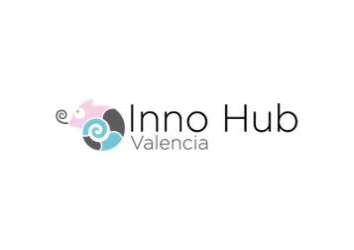




EQUIPO SHOOT

Slide 35


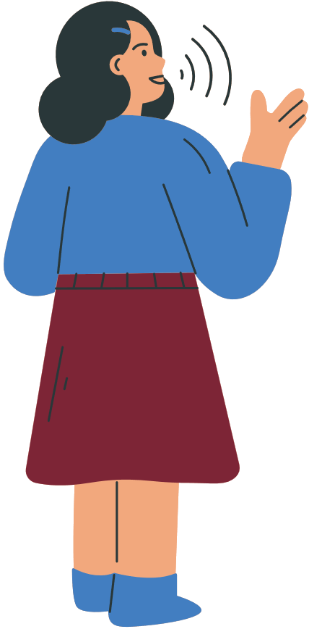
EVALUACIÓN DE TU HISTORIA DIGITAL Preguntas de autoevaluación Contenido:
EVALUACIÓN DE TU HISTORIA DIGITAL Preguntas de autoevaluación Contenido:
¿Mi historia tiene un mensaje o propósito claro?
¿Las imágenes comunican eficazmente ese mensaje?
¿La secuencia es lógica y emocionalmente coherente?
Técnico:
¿La calidad de la imagen es suficiente (enfoque, iluminación, composición)?
¿El audio es claro y está equilibrado con los elementos visuales?
¿Las transiciones son fluidas?
Ético:
¿Obtuve los permisos y consentimientos necesarios?
¿Todos los materiales están debidamente referenciados y atribuidos?
¿Mi historia representa a los sujetos con respeto y precisión?
Impacto:
¿Qué emoción o comprensión espero que obtengan los espectadores?
¿Logré eso en mi borrador? ¿Qué necesita mejorar?
Notes:
CONTENT evaluation is about storytelling effectiveness.
TECHNICAL evaluation is about craft. Watch your story on mute—do the images tell the story visually? Listen to it without watching—does the audio stand alone? Both should be strong.
ETHICAL evaluation is about responsibility.
IMPACT evaluation is about efficacy.
Tip: watch your story as if you were the audience

