Slide 1



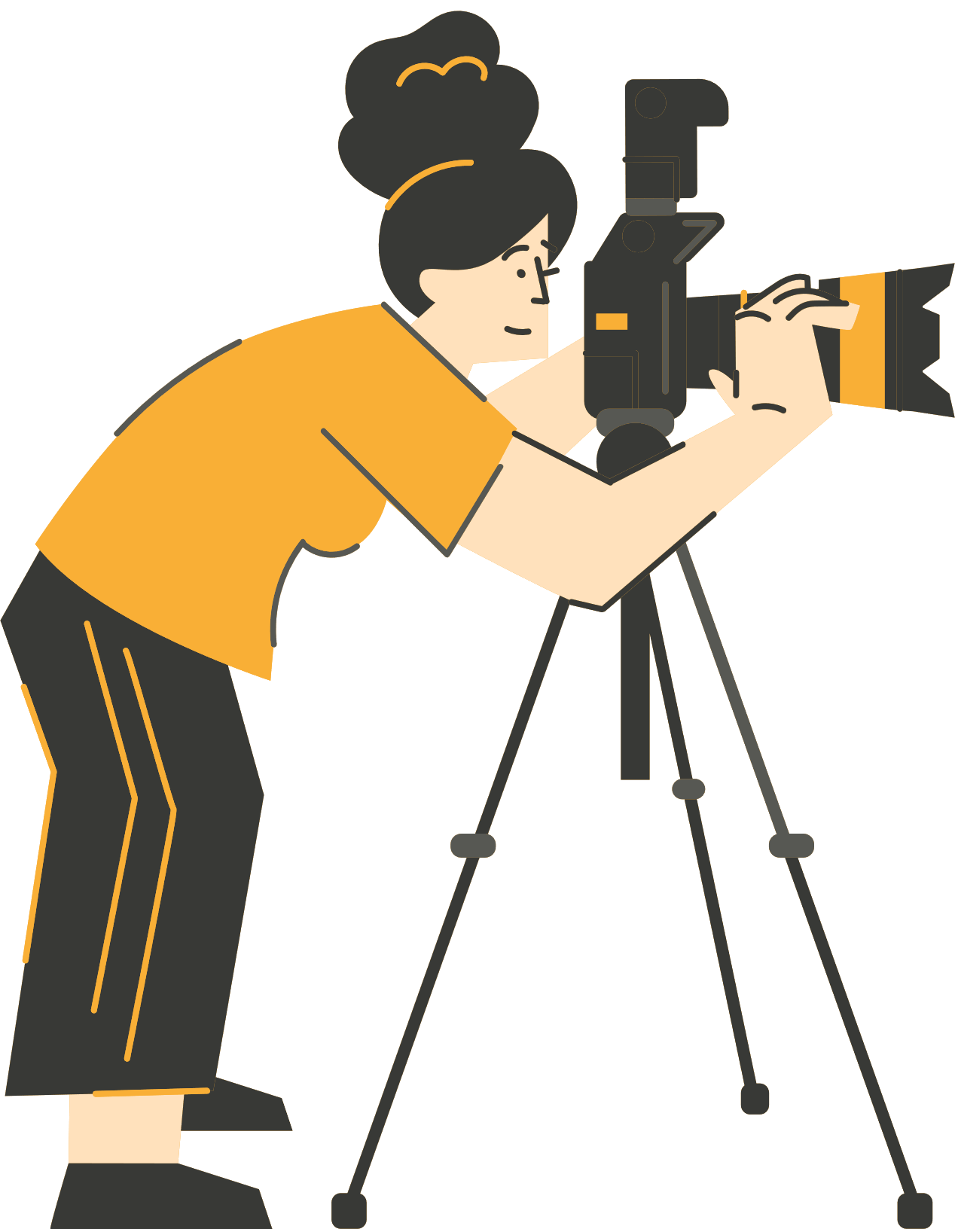




NARRACIÓN A TRAVÉS DE LA FOTOGRAFÍA DIGITAL
WP3 Metodología
Construcción de historias y técnicas de comunicación efectiva.
Funded by the European Union. Views and opinions expressed are however those of the author(s) only and do not necessarily reflect those of the European Union or the European Education and Culture Executive Agency (EACEA). Neither the European Union nor EACEA can be held responsible for them.

Slide 2
CONTENIDOS
Webinar 2: Construcción de historias y técnicas de comunicación efectiva
Del concepto al guión gráfico – fundamentos del storyboard
Desarrollo de personajes, escenarios y temas
Habilidades de fotografía digital para la narración
Técnicas de comunicación efectiva
Actividad 1
Actividad 2
Recapitulación de mejores prácticas
Reflexión y preguntas y respuestas
Referencias y bibliografía
Notes:
Today, we're getting practical: we are going to sea how to plan your story visually through storyboards, remember basic photography techniques (to use them effectively in a story), and develop your narrative voice1

Slide 3
La metodología de narración a través de la fotografía.
Esta metodología introduce un enfoque innovador para la enseñanza al integrar la narración digital a través de la fotografía. Basada en la neurociencia, la narración fomenta conexiones emocionales, lo que hace que la información sea más accesible y memorable.
Aborda los desafíos que enfrentan los estudiantes desmotivados y aquellos con dificultades de aprendizaje al aprovechar tecnologías contemporáneas para crear un entorno de aprendizaje atractivo e inclusivo.
La narración aumenta la participación, la creatividad y la comprensión en las distintas áreas curriculares, a la vez que se adapta a diversas necesidades de aprendizaje, incluidos los estudiantes con dificultades de aprendizaje.
Notes:
Quick reminder of our foundation. We're moving from "why" to "how"—the practical skills that bring stories to life.

Slide 4



Webinar 2: Construcción de historias y técnicas de comunicación efectiva.
Notes:
Today we are going to work from developing an idea into a story and the storyboard process in order to have a clear story structure.
We will se how we can captivate our audience by using the right tone and language to communicate, and some techniques that help us speak confidently in public or on camera.

Slide 5


Del concepto al guión gráfico
¿Qué es un storyboard?
Un mapa visual de tu historia.
Tiene un principio y un final
Avanza cuadro por cuadro como un esquema visual
Documenta las transiciones (cómo se mueven las personas, los ángulos de cámara, el zoom)
Apoya la visión creativa
Y la ejecución técnica
Ayuda a planificar antes de la grabación/fotografía
Notes:
Storyboards help translate ideas into visuals. They allow you to experiment with sequence and pacing before shooting or creating a digital story. They are visual planning tools that organizes a narrative into a sequence of images, help refine the flow and safeguard the conceptual and technical part. A storyboard doesn't need to be artistic—stick figures work! What matters is planning: What's in each frame? What happens between frames? How does the story flow?
Expert in digital storytelling Jason Ohler (2013) emphasizes that storyboarding fosters critical thinking by requiring creators to connect images meaningfully encouraging them to keep a focus in both intended audience and intended message to convey.
You can storyboard on paper, use PowerPoint, Google Slides, or tools like Canva.

Slide 6

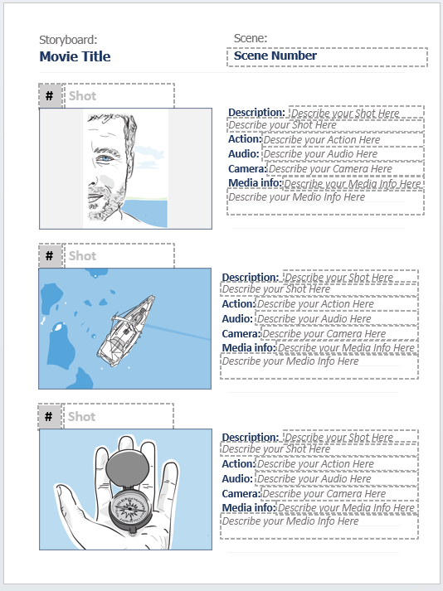
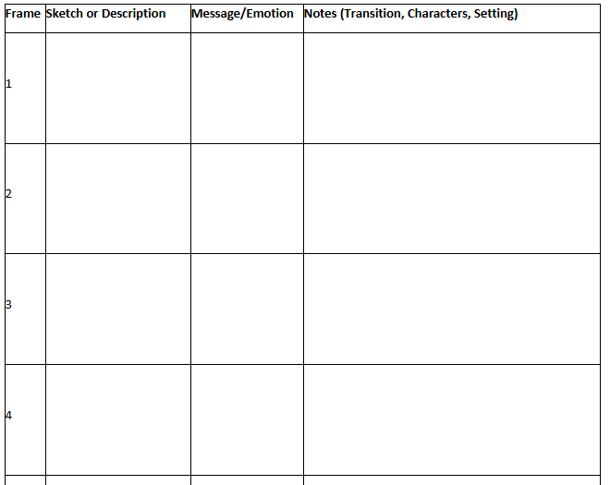
Del concepto al guión gráfico
https://www.canva.com/design/DAGyAK39miA/zflU91Ubyqgsa852PM5x2w/edit?referrer=storyboard-landing-paget
Notes:
So to go from the concept to the storyboard, first you focus on a clear idea, message, concept. Then, you break it into the most basic scenes. Next, you sketch those scenes to show what’s happening and how the story flows. The storyboard helps you see the story visually and from a good distance that offers critical view. This is a storyboard, a page with boxes like a comic where we see basic scenes or photos and some text indicating what is happening or should happen in the making. You can find templates for storyboarding in presentation programs like Powerpoint or Canva, or you can just create a grid by yourself to help you organise and build your story. Remember that in a storyboard, the important thing is the visual part and not the words!
Notice how each frame shows the essential action and includes notes about what's happening. You don't need artistic skill—clarity is what matters. Even professional filmmakers often use rough sketches.

Slide 7
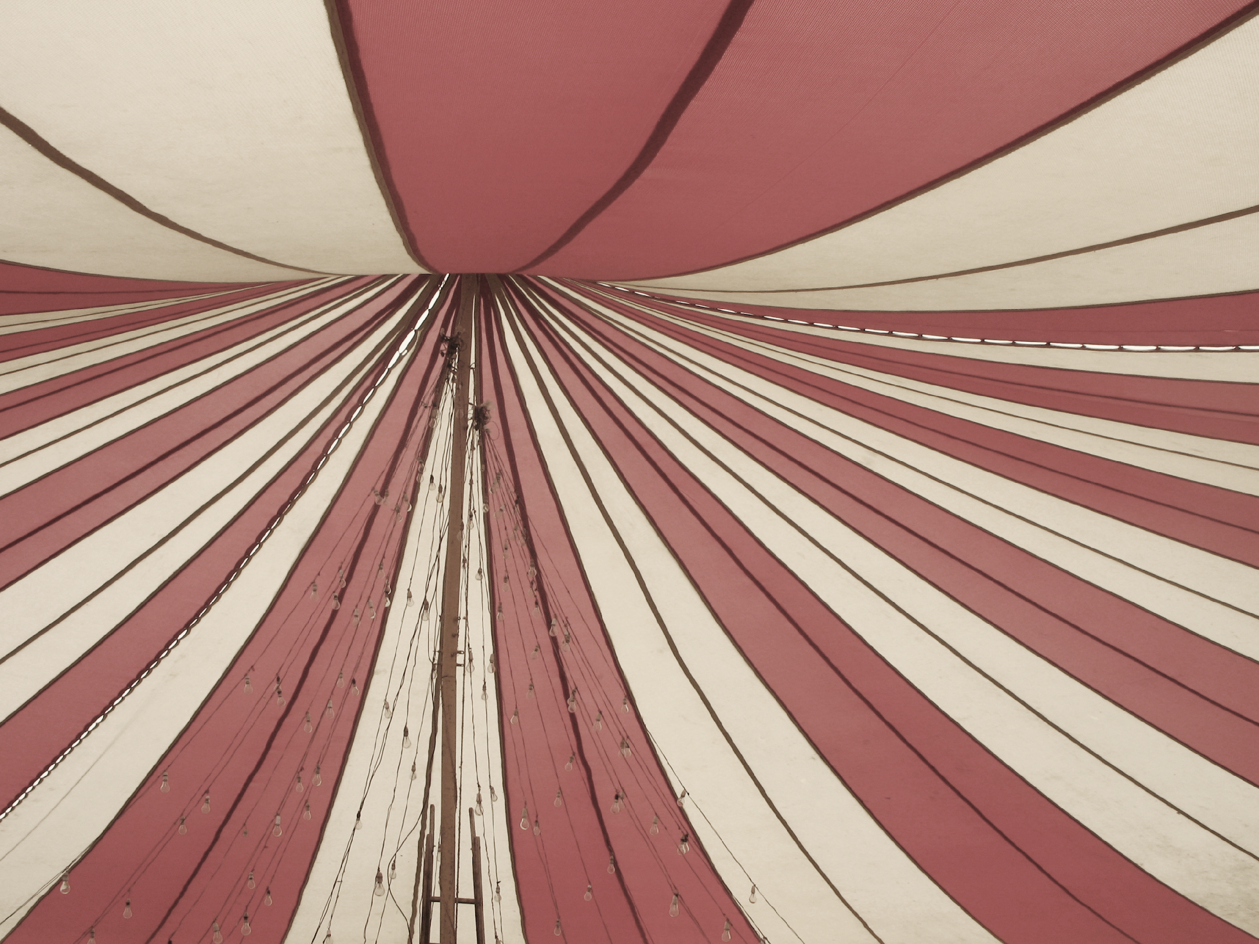
ACTIVIDAD 1
Crea un storyboard para una escena de una película de Charlie Chaplin (La jaula del león – Charlie Chaplin, El circo, 1928).
Usa dibujo a mano sencillo en papel y luego una herramienta digital con una estructura tipo PowerPoint, como Canva o Google Slides.
Intenta crear el escenario, la época, los personajes y las transiciones.
Comparte tu storyboard con tus compañeros y discute las decisiones narrativas.
https://www.youtube.com/watch?v=Mm1N_3Inf9o
Notes:
Now you’ll apply these concepts by creating your own storyboard on an existing scene. We're using Chaplin because silent film makes visual storytelling very clear—no dialogue to rely on. As you watch, note the physical comedy, the tension building, how the cage creates danger. When storyboarding, you don't need to capture every second—focus on key moments that advance the story. Don't worry about drawing skill; stick figures are fine. What matters is capturing the essence of each shot.
Focus on clear narrative flow and meaning and not artistic perfection. Peer feedback to each other in pairs. The video you use is here https://www.youtube.com/watch?v=Mm1N_3Inf9o . From this almost 3 minutes create a storyboard of max 10 images
Guiding questions:
What is Chaplin's character trying to do?
How does the setting (circus cage) add tension?
What camera angles does the director use?
How do transitions move the action forward?
Debriefing: How did Chaplin use physical space? What made the story clear without words? How did your storyboard differ from others?
SAME SCENE, DIFFERENT STORYBOARDS- UNIQUE NARRATOR’S PERSPECTIVE

Slide 8



Desarrollando los elementos de tu historia: personajes, escenarios y temas
1. PERSONAJES
Personas, objetos o símbolos clave que transmiten significado. ¿Quién es el centro de tu historia? ¿Qué representan?
Ejemplo: En La Odisea de Homero — Odiseo (héroe/viaje), Penélope (lealtad), pretendientes (obstáculos)
Notes:
Every story, even a 5-photo sequence, needs these three elements. Let's break them down:
CHARACTERS don't have to be people. In a science story about erosion, your "character" might be a rock. In a story about climate change, it could be a polar bear or a melting glacier. Characters carry the emotional weight of your story—they're what audiences connect with.
Developing the characters sounds complicated but its fundamental and can be done simply. Characters can be people, objects or symbols and they all carry meaning. Think of a story you all know: Homer's Odyssey. Odysseus its the main character, his companions secondary characters, but important characters are also his wife Penelope and his son Telemachus and of course, the monsters and creatures and gods that he meets along the way. Identify orally the meaning or symbolism of each character. Recognize the context, the feeling of the characters. Explore great themes such as nostos (homecoming), filoxenia (hospitality), free will, fate of human, power of gods, exploration, identity formation.

Slide 9
Desarrollando los elementos de tu historia: personajes, escenarios y temas
2. ESCENARIOS Dónde y cuándo ocurre tu historia. El tiempo y el espacio establecen el contexto y el ambiente.
Ejemplo: El viaje de La Odisea a través de los mares (aventura, peligro, lo desconocido)
3. TEMAS Ideas más amplias: identidad, cambio, justicia, pertenencia, progreso.
Ejemplo: La Odisea explora el regreso al hogar, la identidad y la perseverancia.
Notes:
SETTING isn't just background. The same scene photographed in harsh noon sunlight versus golden hour tells a different emotional story. A classroom versus outdoors changes meaning. Setting creates mood.
THEMES are the "so what?" of your story. If you're documenting a school garden project, the theme might be growth, community, or sustainability. Theme gives your story depth beyond surface details.
When planning your story, ask: Who/what is my character? Where does this happen? What bigger idea am I exploring?.

Slide 10

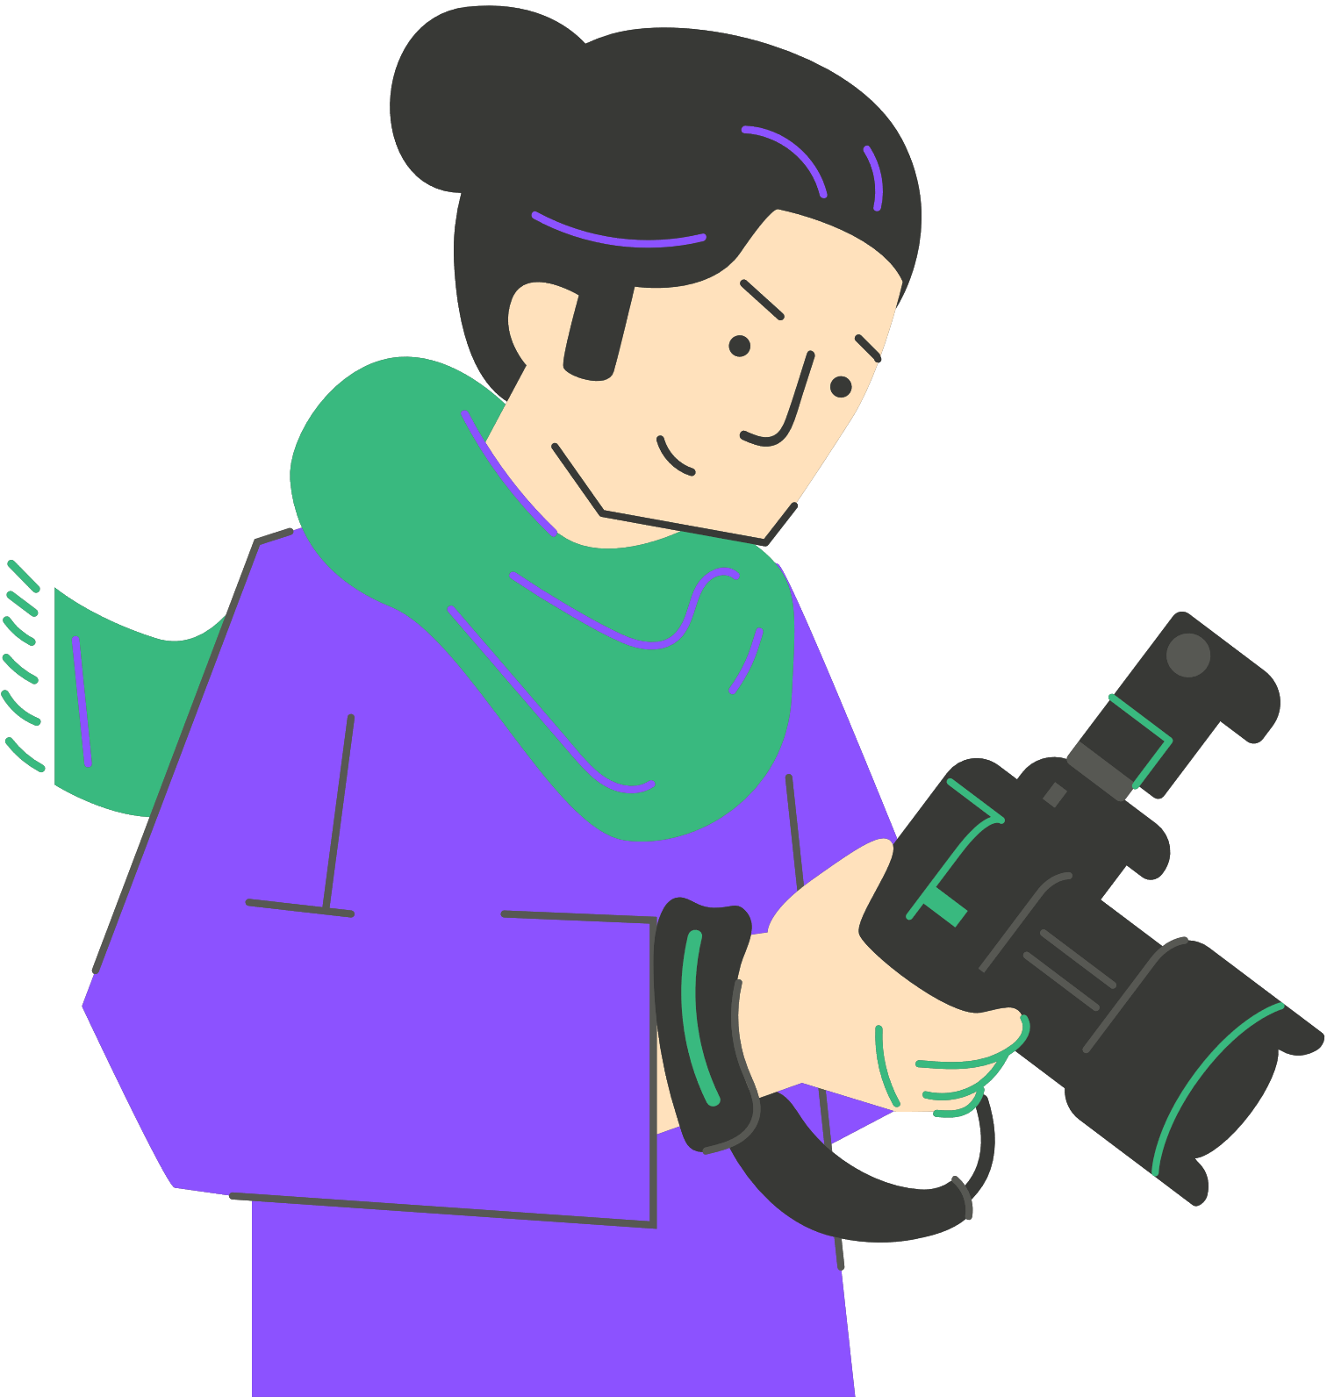
Habilidades de fotografía digital para la narración – Fundamentos de la composición
Regla de los tercios: divide el encuadre en una cuadrícula de 3x3; coloca los elementos clave en las intersecciones para crear equilibrio.
Líneas guía: carreteras, escaleras, sombras, ríos que dirigen la mirada del espectador, creando profundidad y movimiento.
Enmarcado: utiliza ventanas, puertas, ramas para centrar la atención en el sujeto. Añade capas y contexto.
Notes:
These three techniques will instantly improve your storytelling images.
Rule of thirds: Instead of centering your subject (which can be static), place it on the intersecting lines. Your eye naturally goes there. Try it—enable the grid on your phone camera.
Leading lines create journey within a single image. If you're photographing a student walking to school, position yourself so the path leads from foreground to the student. The viewer's eye follows that path.
Framing adds context and focuses attention. Photograph someone through a window frame, and you've suggested inside/outside, observer/observed. Layers create meaning.
Practice these consciously until they become intuitive.

Slide 11

Habilidades de fotografía digital para la narración –
Alfabetización visual
Comprender cómo las imágenes crean, representan, comunican y alteran el significado
3 herramientas poderosas
LUZ COLOR PERSPECTIVA
Notes:
It's not only about composition techniques though, it's also about understanding images. Visual literacy means reading images like you read text. Just as word choice matters in writing, your visual choices matter in photography.
A high visual literacy offers a solid basis for crafting conceptually and emotionally resonant narratives but also the participation in the creation of narratives (particularly for collaborative ones) is also a way to work on one’s visual literacy skills. Try to interpret images around you. Symbols, photos, artworks, advertisements. They all have a lot of information inside and each single image of them can be studied deeply.
In visual storytelling, the deliberate use of light, color, and perspective can dramatically alter how a narrative is perceived and felt by the audience. You already know that color carries deep psychological and cultural symbolism: think of the red and blood, danger, anger, you name it. Think of Wes Anderson films, do you know any? He is famous among other things for how he turned traditional painterly color pallets into cinematic visuals to create a unique style in his storytelling. Perspective means really how the camera frames the subject. Think of the angle of a kid and the angle of you in how you look at things. It's actually a different camera angle because of the difference in height. Playing with the perspective creates tension, emotion, atmosphere trough visual navigation in the setting. See the photo of Ansel Adams who waited for the perfect moment when moonlight reflects the crosses and church in the foreground against a dark sky.
We’ll see a few examples of technical elements in famous photos, that can enhance the meaning of the theme photographed.

Slide 12
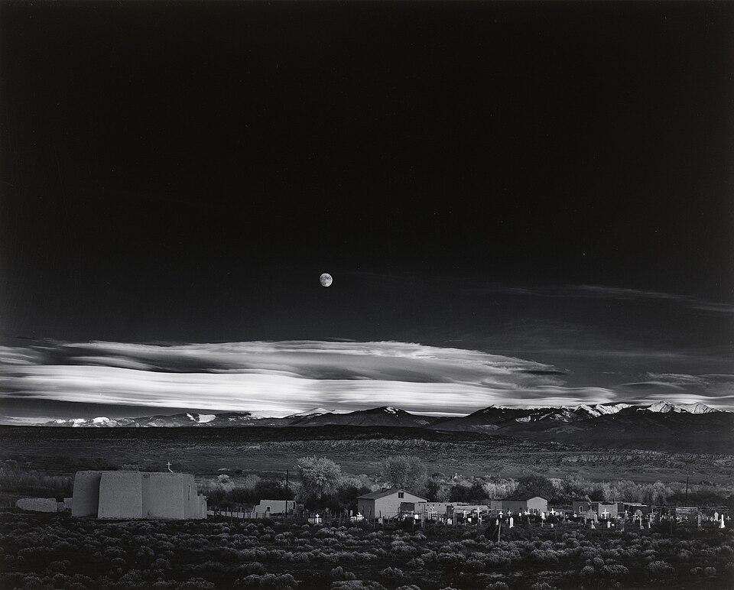
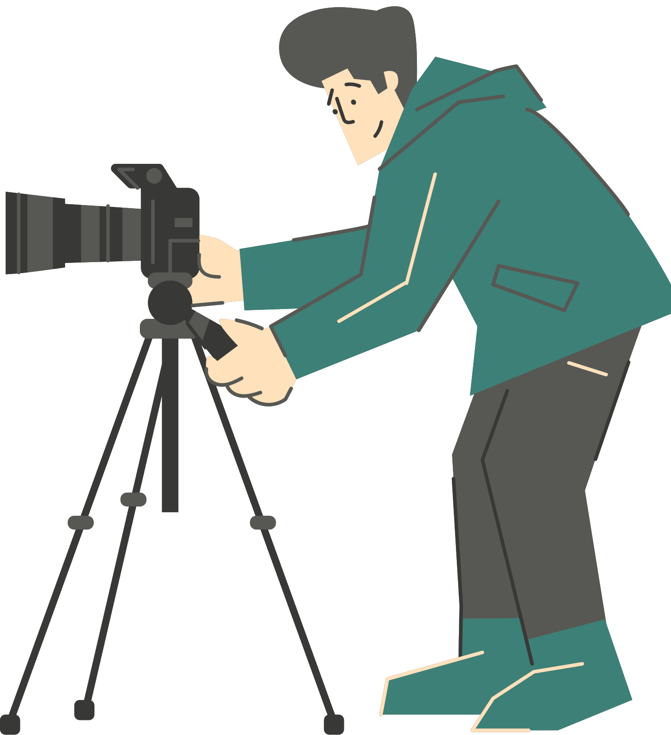
Uso de la luz
Natural vs. artificial
Dura vs. suave
Las sombras crean atmósfera, drama y misterio
Ansel Adams “Moonrise, Hernandez, New Mexico”
Notes:
LIGHT is your primary storytelling tool. Morning light is soft and hopeful. Harsh noon sun creates strong shadows and can feel intense or hostile. Golden hour (before sunset) is warm and romantic. Overcast days give even, gentle light. Shadows can hide or reveal. Natural light often brings realism while intense artificial lighting produces an intense tone and a touch of surrealism.
Adams waited for the perfect light for that moonrise shot—the drama comes from the interplay of light and shadow on the landscape.

Slide 13
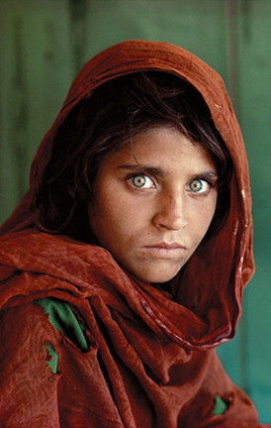
Uso del color
Impacto psicológico: rojo (pasión, peligro), azul (calma, tristeza), verde (naturaleza, crecimiento)
El simbolismo cultural puede variar
El blanco y negro elimina la distracción del color y enfatiza la forma y la emoción
Steve Mc Curry, “Afghan Girl”
Notes:
Color isn't decorative—it's emotional. Warm colors (red, orange, yellow) feel energetic, aggressive, passionate. Cool colors (blue, green, purple) feel calm, distant, or sad.
In the Afghan Girl portrait, that piercing green against the red creates tension and draws you to her eyes—the windows to her experience.
When planning your story, think: What mood do I want? What colors support that? Sometimes black and white is most powerful because it removes color's emotional noise and lets the subject speak.

Slide 14
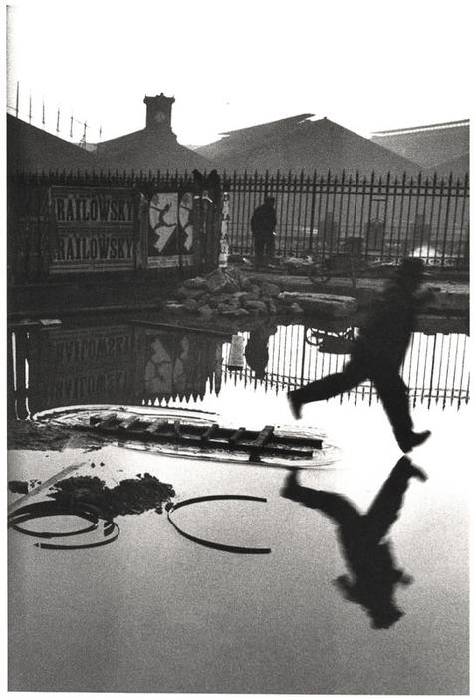
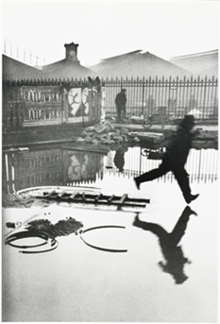
Uso de la perspectiva
Los ángulos de cámara influyen en la participación del espectador y en las dinámicas de poder.
Ángulo bajo (cámara debajo del sujeto) = poder, dominio, dramatismo
A nivel de los ojos = igualdad, intimidad, conexión
Ángulo alto (cámara por encima del sujeto) = vulnerabilidad, debilidad, contexto
Henri Cartier-Bresson “Behind the Gare Saint-Lazare”
Notes:
Perspective is about power and relationship. Photograph a child from adult height looking down, and they seem small, vulnerable. Get down to their eye level, and suddenly you're equals—we connect differently. Shoot from below looking up at a student presenting their work, and they seem confident, powerful. These aren't accidents; they're choices. Think about the relationship you want between viewer and subject. Cartier-Bresson's low angle transforms an ordinary moment (man jumping a puddle) into something balletic and magnificent. That's the power of perspective
H
is low-angle perspective which can freeze motion and create narrative tension . As the artist himself famously said, to photograph is to put on the same line of sight the head, the eye and the heart.

Slide 15
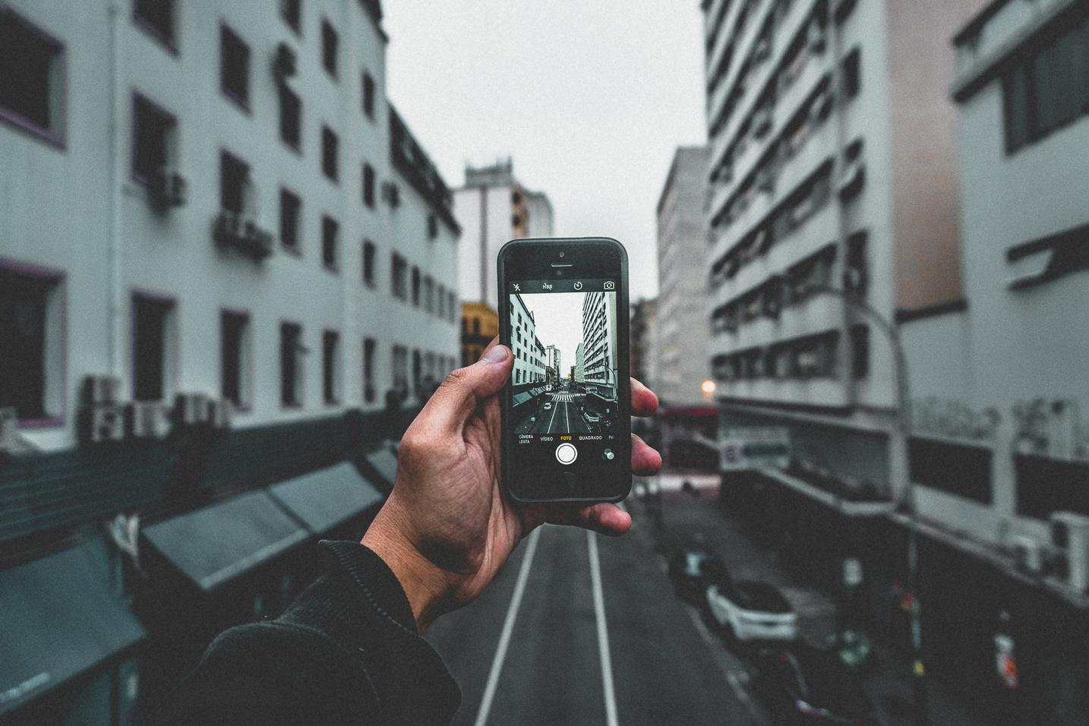
Recapitulación de mejores prácticas
Mantén las narrativas simples y auténticas
Prioriza la resonancia emocional y la conexión con la audiencia
Recuerda la importancia del storyboard para organizar la narrativa
Organiza y reorganiza los elementos de la historia según sea necesario
Notes:
To keep narratives simple and real as we said before, to never forget the emotional impact and the engagement of the audience, and to be able to organise and reorganise ideas after feedback, reflection, discussion. All this are important qualities that can be seen as best practices. And keeping in mind again, that the technical aspects are not just technical, all our technical choices are also creative and show the artistic, conceptual, emotional background of the story.

Slide 16
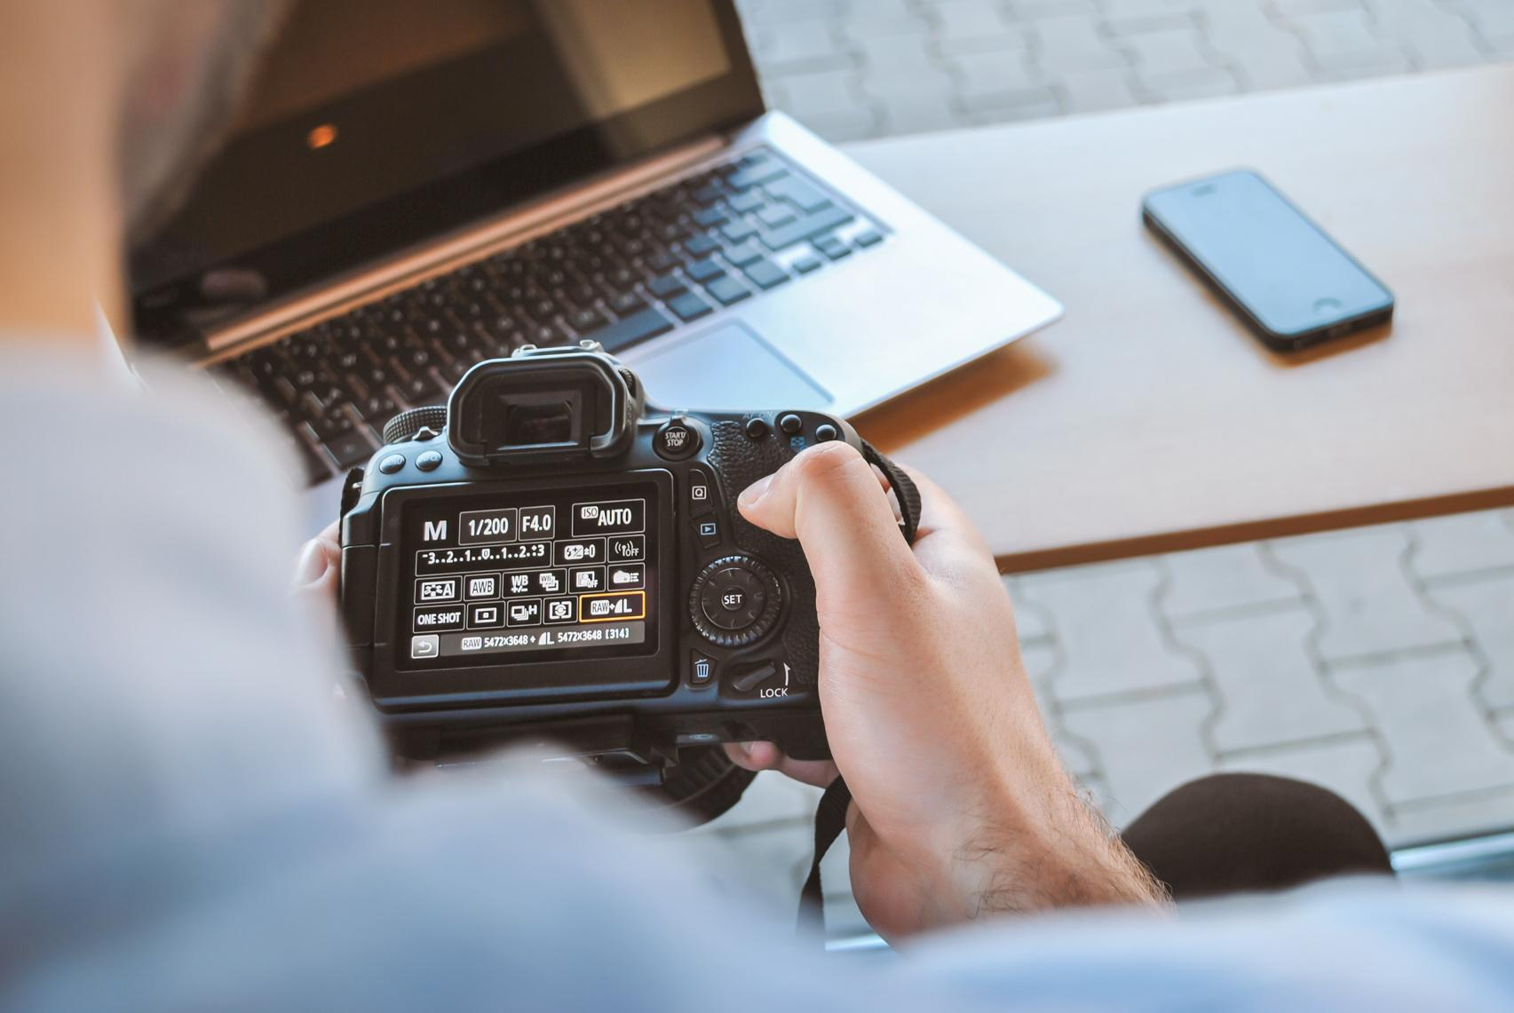
ACTIViDAD 2
Crea un storyboard para tu propia historia fotográfica corta (3-5 imágenes).
Usa dibujo a mano sencillo en papel y luego una herramienta digital con estructura tipo PowerPoint, como Canva o Google Slides.
Comparte tu storyboard con tus compañeros y discute las decisiones narrativas.
Primero la idea, luego el mensaje, después el concepto y finalmente el storyboard.
Notes:
To be successful now in creating youn storyboard first choose a simple story idea with a clear beginning, middle, and end. Think of the photography techniques we just discussed. Where will you use rule of thirds? Leading lines? What perspective supports your message? What kind of light do you want?
Your storyboard is your guide when you eventually shoot. The clearer your plan, the easier the execution.
Activity to be done offline
Idea for implementation: Plan a 3-5 image photo story on a topic of your choice
Step 1 Brainstorm your concept
What's your message? Who/what is your character? What's your theme?
Step 2 : Create storyboard (hand-drawn, then digital)
Sketch each frame. Note camera angle, lighting, composition technique Write brief description of each shot Plan transitions between images
Step : Partner share
Present your concept and storyboard
Get feedback: Is the story clear? What could be stronger? Revise if needed
Remember: You're not shooting photos yet—you're planning!
Divide your story into five moments, then draw a box for each scene or use Canva where you search for template of storyboard In each box, sketch what the photo might look like abstractly and write a short description of what’s happening, who is in the shot, what emotion it shows, and what kind of shot or angle you’ll use. Think about how each image connects to the next. Keep it simple, focus on the message, and plan your photos before you shoot with your phone or digital camera.
Indicative feedback questions: “What's your theme?" "How does this angle support your message?" "What happens between frame 2 and 3?“
Food for thought-discussion: The shift from "I want to photograph X" to "I want to show Y through images of X" is huge. That's moving from documentation to storytelling. Your storyboard forces you to think sequentially: How does image 1 set up image 2? How does the series build to a conclusion? This planning makes you a storyteller, not just a photographer

Slide 17
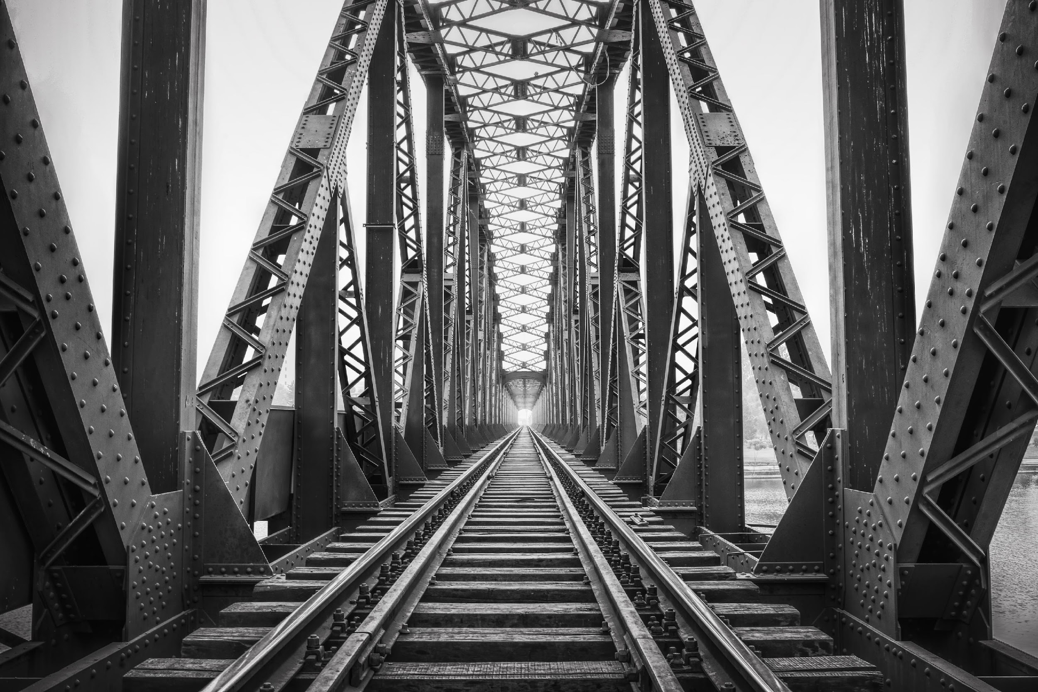
Recapitulación de mejores prácticas
Mantén las narrativas simples y auténticas
Prioriza la resonancia emocional y la conexión con la audiencia
Usa storyboards para organizar la narrativa antes de la grabación
Sé flexible para reorganizar los elementos de la historia si es necesario
La verdad emocional es más importante que la perfección técnica
Composición, luz, color y perspectiva = tu vocabulario visual
Notes:
Let's crystallize what we've covered.
The best stories are clear and honest.
Authenticity beats technical perfection every time.
A slightly blurry photo with genuine emotion is more powerful than a technically perfect but empty image.
Use your storyboard as a flexible guide, not a prison—if you discover something better while shooting, follow it.
But having the plan gives you something to deviate from intentionally rather than wandering aimlessly.

Slide 18
Técnicas de comunicación efectiva
Notes:
A photo story can stand alone, but often you'll present it—in class, online, to an audience. Your voice becomes another storytelling tool. Just as you made intentional choices about composition and light, you can make intentional choices about how you speak. This part is especially important to those who feel anxious about presenting.
Telling a visual story is not only about images. Sound plays a very important part, in the form of music or sound that punctuate your story, but also in the form of narration.
Remember that event the word “Storytelling” is about speaking! And to be able to captivate your audience, to make them pay attention to your story, and remember it afterwards, you need to know (and use) the basics of effective communication!

Slide 19

Uso de la voz y el ritmo para captar la atención
Tu voz es tu herramienta más poderosa para contar historias.
Tono: expresa emociones — calma, entusiasmo, curiosidad, suspense.
Ritmo: reduce la velocidad para ideas clave, acelera durante la acción.
Pausas: el silencio añade énfasis y permite que el oyente reflexione.
Volumen: variarlo mantiene el interés y resalta lo importante.
Fluidez: crea un flujo natural que coincida con el estado de ánimo de la historia.
Notes:
Think about the difference between reading a list of facts versus hearing a gripping story. The difference is often voice.
Tone carries emotion. Say "I never thought it would happen" in a fearful whisper versus an amazed celebration—same words, completely different meaning.
Pace creates tension and release. Slow down for important moments: "And then [pause]... she realized." Speed up for action: "He ran through the hallways, past the office, out the door."
Pauses are powerful. Silence makes audiences lean in. After saying something important, pause. Let it land.
Practice this: Read one sentence from a book multiple ways—excited, sad, mysterious, urgent. Notice how your voice changes the meaning.

Slide 20
Habla con claridad – usa palabras que todos comprendan
Principios de comunicación inclusiva
Usa un lenguaje simple y concreto
Evita jerga y frases largas
Elige palabras cortas con imágenes potentes: correr, construir, compartir, soñar, proteger
Al enseñar a grupos multilingües o con habilidades mixtas, busca claridad, no complejidad
La inclusividad comienza con un lenguaje que dé la bienvenida a todos
Notes:
Clarity isn't "dumbing down"—it's respecting your audience. Academic language and jargon exclude people. Concrete, vivid language includes them.
Compare the phrases: "The precipitation event initiated a cascading ecological response" versus "When the rain came, everything changed." Same information, but the second invites everyone in.
This matters enormously in diverse classrooms. Students with language-based learning differences, multilingual learners, and those with processing challenges all benefit from clear, direct language. And guess what? So does everyone else. Strong, simple words create vivid mental images. That's powerful communication.
When presenting your photo stories, avoid explaining with complex terminology. Trust your images and use words that amplify, not complicate

Slide 21


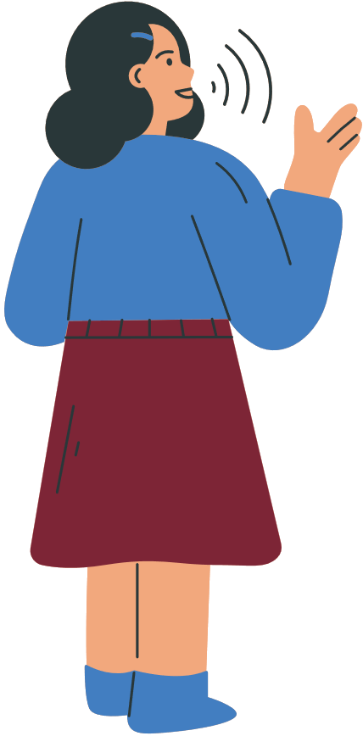

Superar la ansiedad y hablar con confianza – Estrategias prácticas
La preparación reduce el estrés: ensaya 2–3 veces en voz alta.
Postura y respiración: mantente erguido, respira despacio y mantén contacto visual (o mira al lente de la cámara).
Voz sonriente: tu tono cambia cuando sonríes — hace que los oyentes se sientan bienvenidos.
Antes de hablar: toma una respiración profunda, haz una pausa y comienza despacio.
Recuerda: la perfección no es el objetivo — la conexión sí.
Notes:
Many people dread presentations, either in front of an audience, or in recording. But the truth is that anxiety is normal, and it is manageable.
Physical preparation helps: Stand tall (it literally changes your body chemistry, reducing stress hormones). Breathe deeply and slowly—when anxious, we breathe shallowly, which increases anxiety. Breaking that cycle helps.
Rehearse OUT LOUD. Thinking through your presentation isn't the same as speaking it. You'll discover awkward phrases, places to breathe, and natural rhythms only by practicing aloud.
The "smiling voice" is real. Even if you're not on camera, smiling while speaking changes your tone. People can hear warmth through audio.
Most importantly: Your audience wants you to succeed. They're not hoping you'll fail. They're interested in your story. Focus on sharing something meaningful, not on being perfect. Some of the most powerful presentations include stumbles, pauses, authentic emotion. Connection matters more than perfection.

Slide 22
Cómo los grandes narradores utilizan la voz y el ritmo
Narradores de TED Talks: Los oradores en eventos TED y TEDx son expertos en usar la voz, el tono y el ritmo para mantener al público completamente atento.
Varían el tono y la velocidad para enfatizar ideas clave.
Usan pausas estratégicas para que las emociones se asienten.
Combinan la narración con autenticidad, comenzando a menudo con una anécdota personal para crear conexión.
Su lenguaje es claro, inclusivo y accesible para audiencias internacionales.
Notes:
Include an episode of Equipo Planeta, https://www.cmmedia.es/play/tv/equipo-planeta to show voice variation. Also use tiktok educational videos in your native tongue.
What to learn from TED speakers: Not to imitate them, but to notice their techniques and adapt them to your authentic voice. Watch any popular TED Talk and you'll see these techniques in action.
They don't speak in monotone. They pause for effect. They use their whole body. They tell stories, not lectures.
But here's what's crucial: each speaker sounds like themselves. They haven't adopted a fake "presentation voice." They've amplified their natural way of speaking with intentional techniques.
That's what you should aim for. Not to sound like someone else, but to be your authentic self, enhanced with skills that help your message land.

Slide 23


Actividad práctica – Voz y expresión oral
En parejas, lean un párrafo corto de un texto elegido (cuento, poema o asignatura escolar).
Los compañeros dan retroalimentación sobre:
Tono y emoción — ¿qué sentiste?
Ritmo y velocidad — ¿demasiado rápido? ¿demasiado lento? ¿variado?
Claridad del habla — ¿fácil de entender?
Repitan la lectura, integrando la retroalimentación para mejorar la expresión oral.
Notes:
This activity can be offline, in a classroom setting or in pairs.
Approximate time needed for each reading-feedback-second reading: 15 minutes
Debrief questions:
How did your second reading differ from your first?
What was most challenging?
What felt surprisingly effective?
Remind students that these are skills, not talents, and thus they can be cultivated! With practice they become naturals.

Slide 24


Próximos pasos:
Realiza tu historia fotográfica según el storyboard
Practica narrarla
Comparte con tus compañeros para recibir retroalimentación
Revisa y presenta

Slide 25


Reflexión y preguntas y respuestas
Reflexiones finales:
¿Cuál fue tu mayor momento de “¡ajá!” hoy?
¿Qué habilidad te emociona más practicar?
¿Qué desafíos anticipas?

Slide 26




Muchas gracias
Funded by the European Union. Views and opinions expressed are however those of the author(s) only and do not necessarily reflect those of the European Union or the European Education and Culture Executive Agency (EACEA). Neither the European Union nor EACEA can be held responsible for them.
Creative Commons licence (either free or 4.0 share alike)

Slide 27


Referencias y bibliografía
Ohler, J., 2008. Digital storytelling in the classroom: New media pathways to literacy, learning, and creativity. 2nd ed. Thousand Oaks: Corwin Press.
Ece Dede (n.d). The Lion Cage - Charlie Chaplin (The Circus, 1928) - with sound [Video]. YouTube. https://www.youtube.com/watch?v=Mm1N_3Inf9o
Adams, A. (1941) Moonrise, Hernandez, New Mexico [online photograph]. Available at: https://en.wikipedia.org/wiki/Ansel_Adams#/media/File:Moonrise,_Hernandez,_New_Mexico.jpg (Accessed: 30 June 2025).
Cartier-Bresson, H. (1932) Behind the Gare Saint-Lazare [online photograph]. Available at: https://en.wikipedia.org/wiki/Behind_the_Gare_Saint-Lazare#/media/File:Henri_Cartier-Bresson_-_Behind_the_Gare_Saint-Lazare,_1932.jpg (Accessed: 30 June 2025). And International Center of Photography (NY) Collection: https://s3.amazonaws.com/icptmsdata/c/a/r/t/cartier_bresson_197_1994_412627_displaysize.jpg
McCurry, S. (1984) Sharbat Gula (Afghan Girl) [online photograph]. Available at: https://en.wikipedia.org/wiki/Afghan_Girl#/media/File:Sharbat_Gula.jpg (Accessed: 30 June 2025).

Slide 28








EQUIPO SHOOT

