Slide 1








NARRAR HISTORIAS A TRAVÉS DE LA FOTOGRAFÍA DIGITAL
WP3 Metodología
Fundamentos de la Narrativa Digital
Funded by the European Union. Views and opinions expressed are however those of the author(s) only and do not necessarily reflect those of the European Union or the European Education and Culture Executive Agency (EACEA). Neither the European Union nor EACEA can be held responsible for them.

Slide 2
CONTENIDOS
Webinar 1: Fundamentos de la Narrativa Digital
¿Por qué contar historias? ¿Qué es la narrativa digital?
Estructura de la historia para narrativas visuales, parte 1
Estructura de la historia para narrativas visuales, parte 2
Resonancia emocional a través de las imágenes
Buenas prácticas para contar historias con fotografía
Actividad 1
Actividad 2
Reflexión y preguntas y respuestas
Referencias y bibliografía
Notes:
Here's our roadmap. We'll move from theory to practice quickly, with two hands-on activities

Slide 3
LA METODOLOGÍA DE NARRACIÓN DE HISTORIAS SHOOT
Esta metodología presenta un enfoque innovador de la enseñanza mediante la integración de la narrativa digital a través de la fotografía.
Con base en la neurociencia, la narración de historias fomenta conexiones emocionales, haciendo que la información sea más accesible y memorable.
Aborda los retos a los que se enfrentan estudiantes desmotivados y aquellos con dificultades de aprendizaje mediante el uso de tecnologías contemporáneas para crear un entorno educativo atractivo e inclusivo.
La narrativa aumenta la participación, la creatividad y la comprensión en las distintas materias curriculares, al tiempo que atiende a la diversidad de necesidades de aprendizaje, incluidos los estudiantes con dificultades.

Slide 4
LA METODOLOGÍA DE NARRACIÓN DE HISTORIAS SHOOT
EL MARCO COMPLETO
Esta metodología incluye una serie de 3 webinars y directrices para formadores. Está pensada para utilizarse junto con la colección de Buenas Prácticas en Narrativa Digital, que también forma parte del WP3.
Se basa en los conocimientos adquiridos a través de los manuales para estudiantes y profesorado “Teaching through Digital Immersive Photography”, desarrollados en el WP2.
Los webinars metodológicos forman parte de un ecosistema educativo integral, en el que el alumnado crea conocimiento de manera activa, implicándose profundamente en los distintos temas curriculares, lo que conduce a las Lecciones Inmersivas desarrolladas por el alumnado en el WP4.

Slide 5



Webinar 1:
Fundamentos de la Narrativa Digital
Hoy exploraremos:
Una introducción a la narrativa digital
Elementos clave en la estructuración de historias
Ejemplos de narración de historias utilizando medios digitales y fotografía
Notes:
Let us dive into the exciting world of digital storytelling and explore together how photography can help us tell powerful stories.
Understand what digital storytelling is, its benefits, and its application in creating immersive lessons.
Why photographic narratives are strong, and how to create compelling narratives using digital images.

Slide 6

¿Por qué contar historias?
3 RAZONES PRINCIPALES
1. Empoderamiento
Compartir voces y perspectivas
Dar espacio a quienes se sienten infrarrepresentados en la escritura
Alternativa a la comunicación basada únicamente en texto
Abordar conceptos complejos desde otros enfoques
Notes:
Let's start with WHY. Throughout human history, stories have been our primary way of making sense of the world. Three reasons matter for education:
First, EMPOWERMENT. Stories can be democratic tools for change. When we tell stories, and even when we hear stories, we feel in control.
Not all students excel at writing essays. Photography gives them another language—one that can express complexity, emotion, and understanding without requiring perfect grammar. Students can create brilliant photo essays about concepts they couldn't write about.

Slide 7

¿Por qué contar historias? (cont.)
2. Reflexión
Comprendernos a nosotros mismos y a los demás
Explorar nuestro pensamiento, identidades e ideas
3. Aprendizaje profundo
Ir más allá de la memorización
Alcanzar una comprensión significativa
Notes:
Second, REFLECTION. When we create stories we’re not just repeating facts. By making a story we are interpreting, connecting to our own lives, reflect on who we are and how we relate to others, to the world around and the complex events that happen daily.
Third, DEEP LEARNING. hat information delivered as stories is significantly more memorable than facts presented in isolation. Stories create context, emotion, and meaning—the three ingredients for lasting understanding. Think about it: you probably remember stories from childhood books, but struggle to recall lists you memorized for tests.

Slide 8

¿Por qué contar historias?
¿Puedes encontrar otras razones?
¿Por qué contar historias?
¿Por qué contar historias ahora?
¿Por qué la gente contaba historias en el pasado?
Memoria personal: ¿cuál es una historia que cambió tu forma de ver algo?
Notes:
Students are free to talk but shortly to keep in point.

Slide 9

¿Qué es la Narrativa Digital?
Contar una historia utilizando fotos + sonido + palabras + imaginación.
Fotografía (tus imágenes cuentan la historia)
Voz / texto (guían el significado)
Música o efectos de sonido (crean la atmósfera)
Por qué es importante:
Recordamos las historias que nos hacen sentir algo. Las fotos nos ayudan a ver el mundo desde la perspectiva de otra persona. Una historia poderosa no depende de herramientas caras, sino de emoción + mensaje.
Notes:
Digital storytelling is simply combining traditional narrative with digital tools. You don't need expensive equipment—smartphones work perfectly. What matters is the story you're telling and the emotion you're creating. A five-image sequence with thoughtful narration can be more powerful than a slick video with no heart. Digital storytelling gives your thematic photos a purpose.

Slide 10



Narrativa Tradicional vs. Narrativa Digital
 | Narrativa tradicional | 💻 Narrativa digital
 | Solo escrita u oral | Combina fotos, voz, vídeo y texto
 | Limitada a palabras | Más formas de expresar ideas
 | La audiencia lee o escucha | La audiencia ve, oye y siente
 | Más difícil de seguir para algunos | Apoya distintos estilos de aprendizaje
 | Comunicación unidireccional | Interactiva, social y compartible
Notes:
Notice the shift from passive to active, from one-way to interactive. Digital stories can be paused, replayed, shared. Students with dyslexia, visual learners, auditory learners—all can engage.
This isn't about replacing traditional writing; it's about expanding our toolkit.

Slide 11
Historia y evolución
De la narración oral a medios en constante cambio:
Oral
Escrita
Impresa
Visual/audiovisual
Digital
Online
Cada tecnología ha ampliado la forma en que contamos historias.
Las herramientas digitales son solo el capítulo más reciente.
Notes:
Digital storytelling is an art. We tell stories using digital tools, media and content. From photos, videos, audio, to 3d objects, digital archival material or emojis, to make our story more engaging.
Telling stories, by using the body, speech, signs, drawings, any media we can imagine, has been an ancient practice of humans and it is crossing through ever changing societies and cultures, often reinventing itself with the different media of each era: oral stories, writing, print, visual and audiovisual media, digital and the online.

Slide 12
Resonancia emocional:
Cómo las imágenes evocan empatía
La fotografía captura momentos, emociones y contexto
Las imágenes comunican más allá de las palabras
Tu punto de vista único se convierte en el protagonista
La implicación emocional ayuda a conectar profundamente con la audiencia
Notes:
We first must introduce the concept of empathy, its social, ethical, personal, political and aesthetic dimensions. In that context, photography is a critical tool for the power of a single image to capture complex emotions , ideas, events, and most importantly: instantly. As important American critic and author who talked a lot about photography, Susan Sontag (1977) said, photographs invite us to empathize with the subject, while generating feelings or new ways of thinking. Furthermore, she believed that photographs do more than just capture moments: they show us reality and sometimes twist it, shaping how we see and understand the world around us.
At school and for a class, when students photograph their interpretation of a concept, they're making creative decisions: angle, light, subject. These decisions reveal understanding. And when viewers see those images, they don't just learn facts—they feel the student's perspective. That's empathy. That's deep learning.

Slide 13

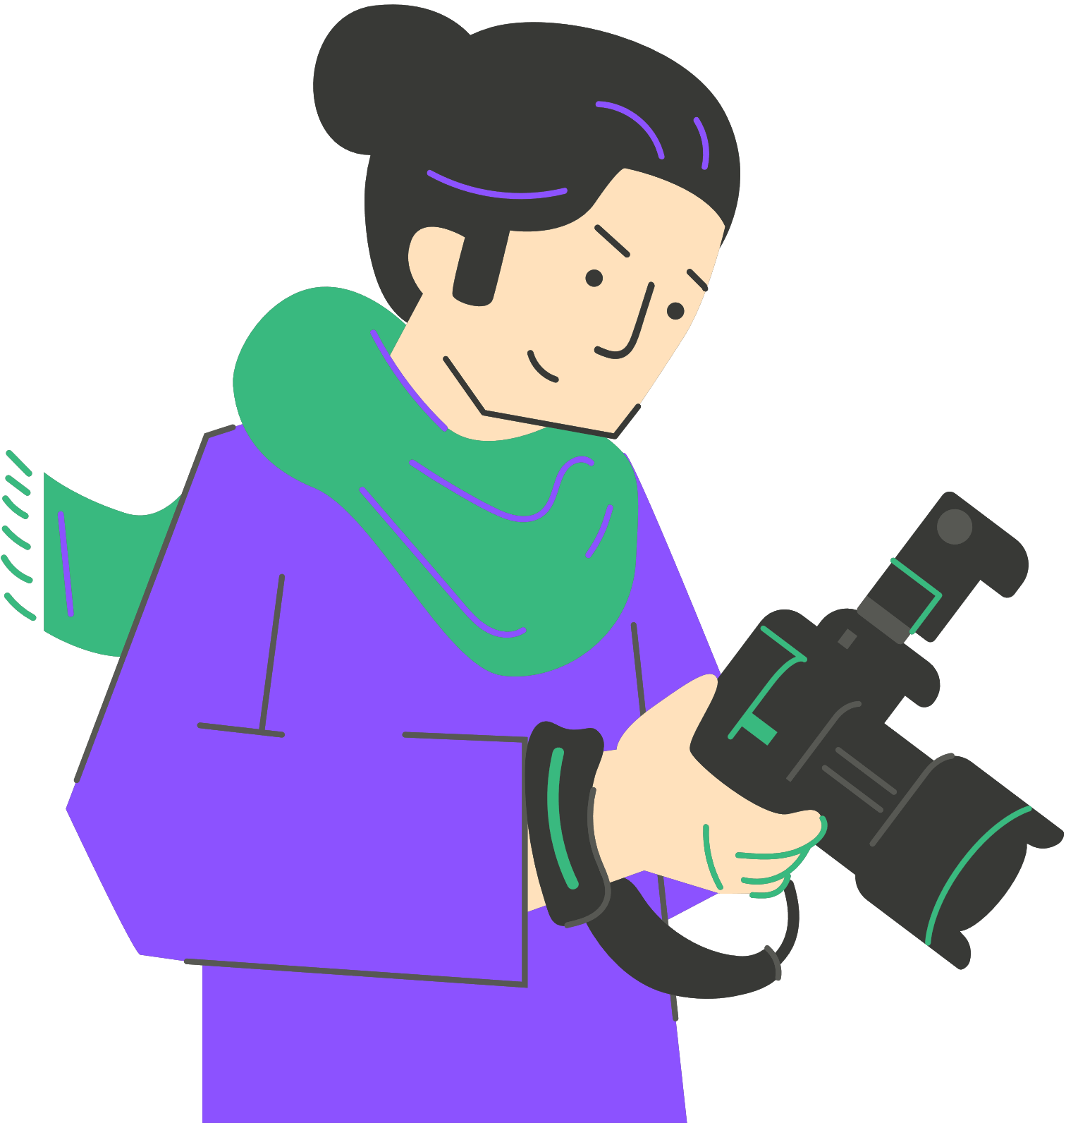
Estructura de la historia para narrativas visuales
part 1
Parte 1 – La pirámide de Freytag
Exposición
Acción ascendente
Clímax
Acción descendente
Resolución
Notes:
It is important to engage with schemes and story structures that work as models to organize visual narratives in terms of understanding , perceιving and also producing. Freytag’s Pyramid was developed by Gustav Freytag, a 19th-century German playwright, novelist, and literary critic, best known for his research around narrative structure analysis. He breaks stories into five parts that reflect the emotional development of the work. Exposition is the beginning of the story, rising action is the moment a tension or change happens, climax as the word indicates is the pick of what happens, falling action shows the impact of what happened, resolution is the end of the story which includes how things will continue to be but also morals, decisions, imagination. This model can be observed often in cinema, in photography, in video games, in classical or other music also.

Slide 14
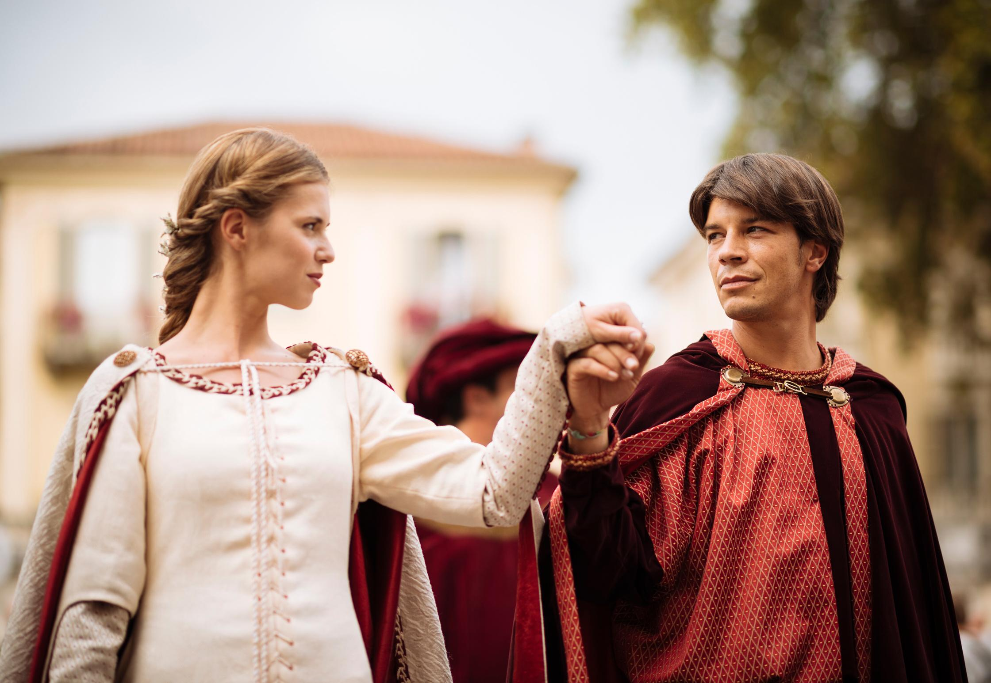
¿Qué historia famosa es esta?
Se presentan dos familias
Un chico y una chica se conocen, se enamoran y se casan a pesar del desacuerdo familiar
Dos asesinatos complican la situación del chico y lo llevan al destierro
La chica finge su muerte para evitar casarse con otra persona
El chico y la chica se suicidan
Notes:
Take some time to think which famous story is here ( Romeo and Juliet). Study the pyramid. Exposition (introducing the families, the Montagues and Capulets). Rising Action. (Romeo and Juliet meet, fall in love, and marry, despite the families disagree). Climax (Two murders make it complex or Romeo , leading to his banishment). Falling Action (Juliet fakes her death to avoid marrying Paris, Romeo doesn't receive the message). Resolution (Romeo and Juliet kill themselves)
Even summarized in bullet points, you can feel the structure—setup, complications building, crisis, tragic resolution. This same structure can guide a 5-photo story about the water cycle or a video about a historical event
It is important to engage with schemes and story structures that work as models to organize visual narratives in terms of understanding , perceving and also producing. Freytag’s Pyramid was developed by Gustav Freytag, a 19th-century German novelisto to analyse narratives. He breaks stories into five parts that reflect the emotional development of the work. Exposition is the beginning of the story, rising action is the moment a tension or change happens, climax as the word inticates is the pick of what happens, falling action shows the impakt of what happened, resolution is the end of the story which includes how things will continue to be but also morals, decisions, imagination. This model can be observed often in cinema, in photography, in videogames, in classical or other music also.

Slide 15
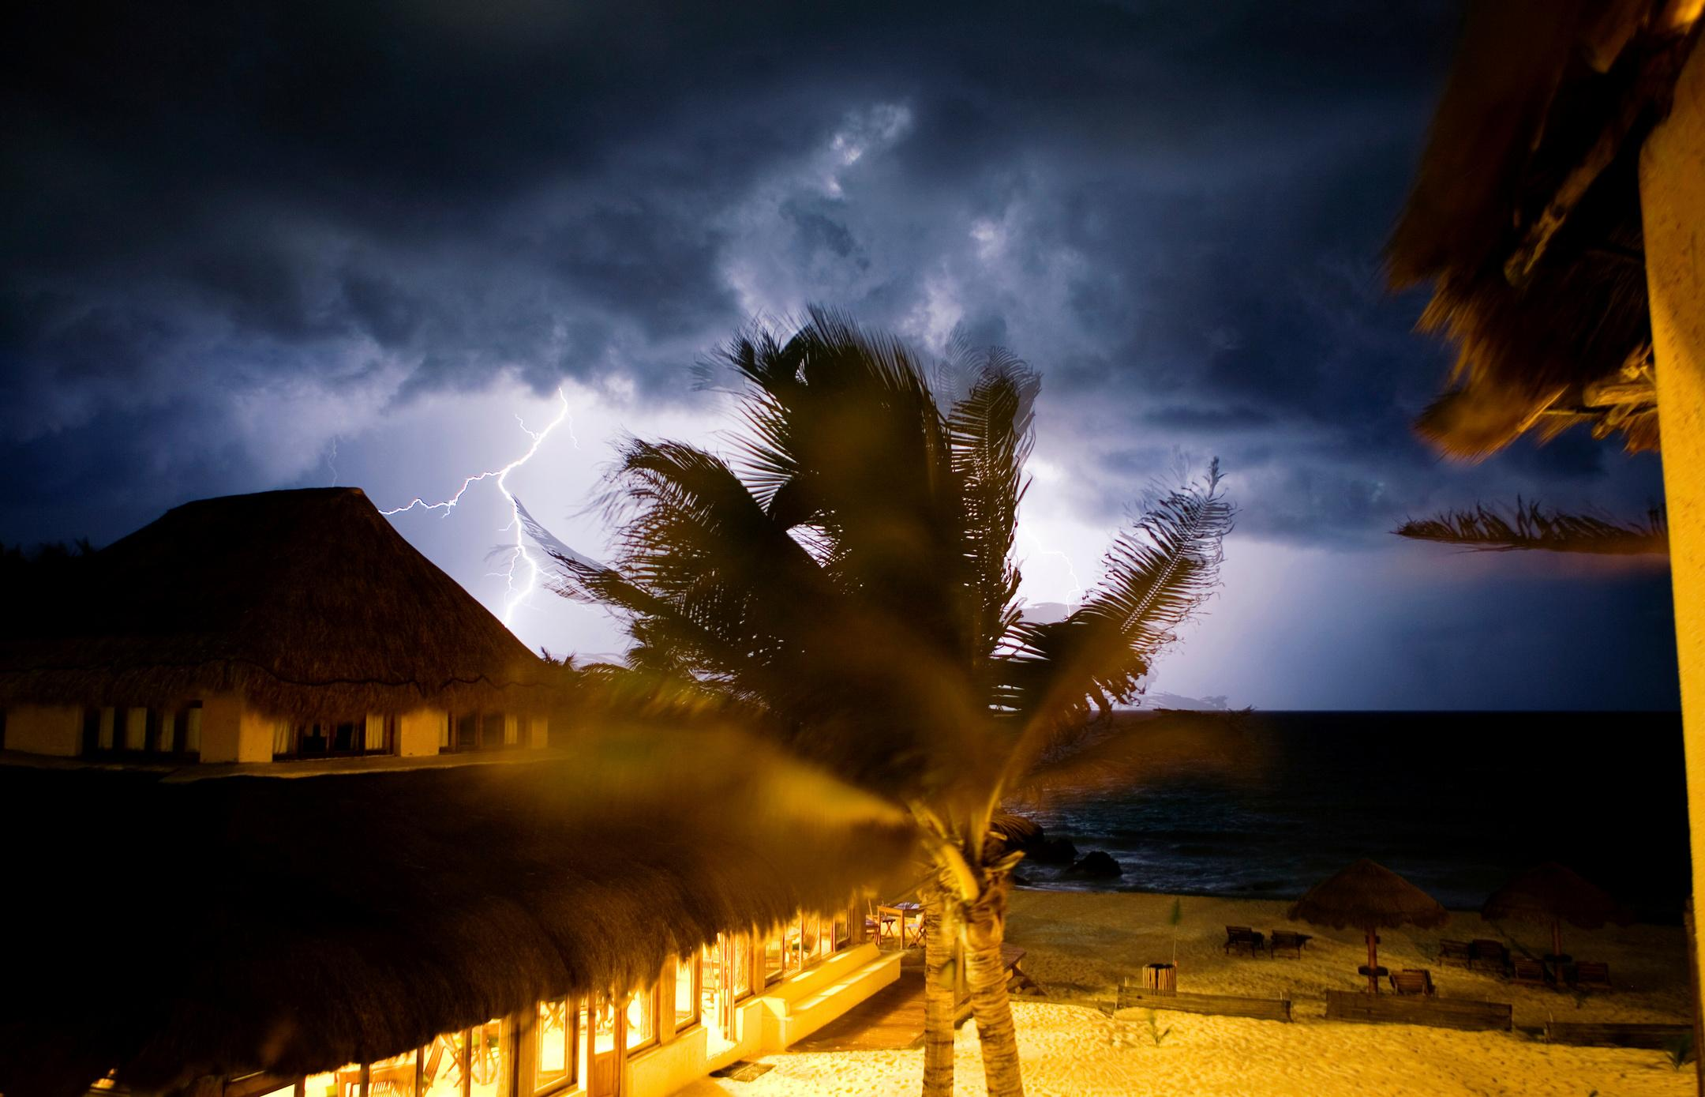
Estructura de la historia para narrativas visuales
Parte 2
Para romper las reglas, primero hay que conocerlas.
Los modelos como la pirámide son fundamentales para tener una base sólida, pero:
Romper los modelos también es válido, siempre que se conozcan
Los nuevos medios crean continuamente nuevas condiciones y entornos narrativos
Los medios digitales son conocidos por romper la continuidad narrativa
Notes:
As french philosopher who talks so deeply about photography, Roland Barthes said, the forms of narrative in the world are infinite, and this is liberating to our expression. It is important to understand this, and particularly how the everytime “new”media create different and alternative story structuring possibilities. Look at the facebook or instagram album . It is already offering an image sequence, you can play with it and make your own rules. Still, to break the rules you need to know them. Digital media are famous for breaking the continuity of narratives.Think of the hypertext, think of auviovisual narratives, think of collaborative digital narratives.
It is important to engage with schemes and story structures that work as models to organize visual narratives in terms of understanding , perceiving and also producing. Freytag’s Pyramid was developed by Gustav Freytag, a 19th-century German novelisto to analyse narratives. He breaks stories into five parts that reflect the emotional development of the work. Exposition is the beginning of the story, rising action is the moment a tension or change happens, climax as the word indicates is the pick of what happens, falling action shows the impact of what happened, resolution is the end of the story which includes how things will continue to be but also morals, decisions, imagination. This model can be observed often in cinema, in photography, in video games, in classical or other music also.

Slide 16



Actividad práctica: una estructura “clásica”
Mira el vídeo titulado “The Underdogs”
Identifica los elementos de la estructura narrativa. ¿Cuánto tiempo tarda cada parte en desarrollarse?
¿Qué emociones te provoca esta historia?
Notes:
“The Underdogs” is the first installment of an Apple advertising campaign showcasing workplace collaboration through its product ecosystem. It is based on dramatization to get through its message.
(recap for the teacher: the film worked because it had a character you could root for, music that built tension, themes of persistence and teamwork. Authenticity matters—even fictional stories need emotional truth. )

Slide 17
Cómo las historias crean conexión emocional
Perspectiva personal: cada historia utiliza una voz individual o un personaje reconocible.
Disparadores emocionales: música, tono de voz, imágenes y ritmo generan empatía.
Temas cercanos: libertad (Walls), dignidad humana (Renia Spiegel).
Autenticidad: experiencias reales o semi-reales hacen que la audiencia sienta, no solo comprenda.
Reflexión compartida: las historias invitan a comparar emociones y valores propios.
Notes:
Let’s see how all these elements are present in real world examples of digital storytelling, creating powerfull stories and also powerful experiences.

Slide 18

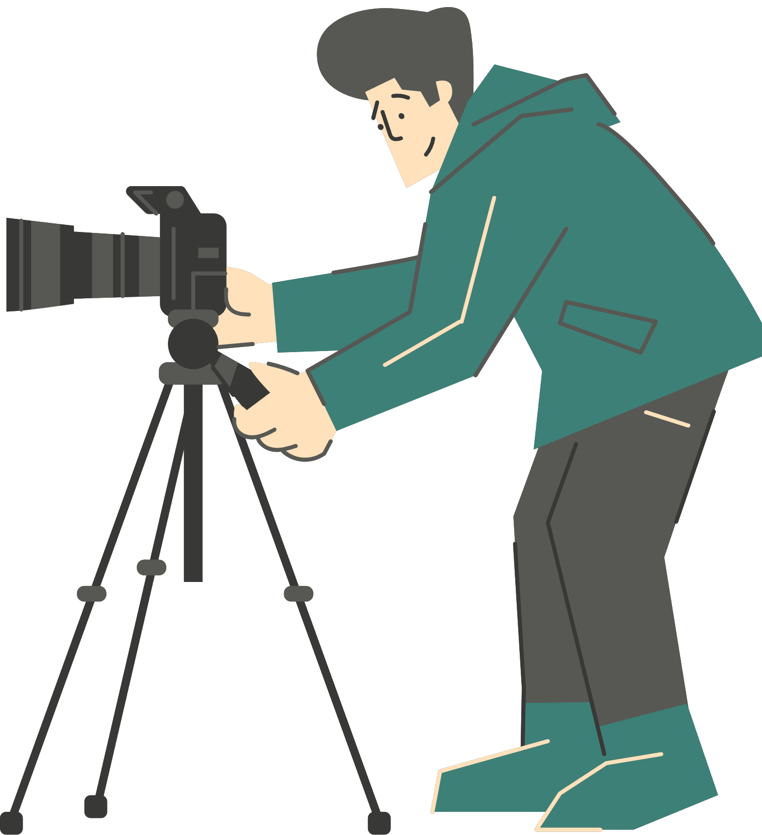
Ejemplos reales de Narrativa Digital
Equipo Planeta
Programa de televisión infantil que combina personas reales, marionetas y animación.
Demuestra cómo la narrativa puede simplificar temas complejos como la sostenibilidad mediante el juego y la imaginación.
Notes:
"The Diary of Renia Spiegel – Digital Storytelling and Education for Human Rights" , is a series of short films from Galicia Jewish Museum in cooperation with the Education and Art Foundation,
The series emphasize education and engagement, showing that storytelling must be rooted in a clear learning or social goal, adapting storytelling style to educational settings, making them digestible and engaging for younger learners.
It touches deeply by linking personal tragedy with broader lessons on human rights. One can see that even in the form of the films, which have a strong narrative, but blend history with personal diaries.
This is a powerful example of digital storytelling for education. Instead of teaching the Holocaust through statistics, this short film uses one girl's diary. We connect with Renia as a person—her hopes, fears, daily life. History becomes human.
One way of creating emotional connection in a story with a clear educational purpose is to take abstract concepts and make them personal.

Slide 19
Actividad práctica: Lluvia de ideas para tu historia
Tarea: Diseñar una historia digital para el aula
Piensa en una asignatura (por ejemplo: Ciencias, Literatura, Historia, Geografía, Arte).
Propón un tema que pueda convertirse en una historia digital que el alumnado pueda fotografiar, narrar o visualizar creativamente.
En pequeños grupos, debatid:
¿Qué mensaje transmitiría la historia?
¿Qué emociones debería evocar?
¿Qué imágenes o voces podrían expresarlo?
Cada grupo comparte una frase que empiece por: “Nuestra historia mostraría al alumnado que…”
Notes:
(Activity can be done out of sequence, as a homework, etc)
Now it's your turn.
Form groups of 3-4 people . Be specific and practical—think about resources available in your school. Don't worry about perfection; focus on the core idea. For example: "Our story would show students that photosynthesis is happening all around them by photographing plants in different light conditions throughout the day."

Slide 20





¡Gracias!
Funded by the European Union. Views and opinions expressed are however those of the author(s) only and do not necessarily reflect those of the European Union or the European Education and Culture Executive Agency (EACEA). Neither the European Union nor EACEA can be held responsible for them.
Creative Commons licence (either free or 4.0 share alike)

Slide 21


Referencias y bibliografía
Sontag, S. (1977). On Photography. Farrar, Straus and Giroux.
Barthes, R. (1981). Camera Lucida: Reflections on Photography. Hill and Wang.
Project Zero Harvard (n.d) Pzs thinking routines toolbox. Available at: https://pz.harvard.edu/thinking-routines (Accessed: 19-6-2025).
Lambert, J., & Hessler, B. (2008). Digital Storytelling: Capturing Lives, Creating Community. Routledge.
McCurry, S. (1984) Sharbat Gula (Afghan Girl) [online photograph]. Available at: https://en.wikipedia.org/wiki/Afghan_Girl#/media/File:Sharbat_Gula.jpg (Accessed: 30 June 2025).
Wegman, W. (1970), Falling Glass. [online photograph]. Available at: https://bpb-us-e1.wpmucdn.com/you.stonybrook.edu/dist/0/2212/files/2017/09/%EC%8A%A4%ED%81%AC%EB%A6%B0%EC%83%B755-2beh3rw.pngAccessed: 30 June 2025)

Slide 22








THE SHOOT TEAM

